Slide 1
2021-2022 Ideal Year of Scouting

Slide 2
IYOS Introduction

Slide 3
How would you like:
A stronger program for your Scouts?
More parental involvement?
More Scouts in your pack or troop?
More Scouts going to camp?
To eliminate-out-of-pocket expenses
Enough money to do all of your activities?
Scouting to be simpler, easier, and more fun?

Slide 4
What is the Ideal Year of Scouting?
Providing a year-round quality scouting program by following the steps in the Ideal Year of Scouting process.
Successfully provide a program “FREE OF CHARGE” to all families.
Provide an “Unparalleled Experience” for scouts.

Slide 5
The Steps to an Ideal Year of Scouting
Plan
Fund
Grow
Train
Recharter
Assess

Slide 6
Plan Your Program

Slide 7
Brainstorming at your unit meeting
What do the Scouts want to do?
Brainstorming can be done at:
Den Meetings
Pack Meetings
Troop Meetings
Have parents watch but not vocally participate
Parents are part of the calendar and budget planning process (next step)
Write down ideas on flip chart or dry erase board.
Notes:
Packs should have a 12 year calendar plan, with at least one pack activities during the summer months to earn the summertime pack award. Day camp in June and resident camp in July are great opportunities for spring recruits to right away get the “outing” in Scouting experience.
The den and pack resource guide can assist new leaders plan their den/pack activities.
Advancement- 1 important milestone is new youth earning and RECEIVING their Bobcat rank within 30 days of joining.
Planning 5 outdoor activities is important because we know for a fact youth join our program to be outside, shoot bow and arrows, go hiking etc.
Service Projects like Scouting for Food are important because it fulfills our promise to parents, teaches our youth the importance of giving back plus shows the community we are here to help.
All of these topics are broken down in greater detail in the IYOS planning guide

Slide 8
Planning an Entire Year
12 month plan of Unit activities
Pack and den meetings, troop and crew meetings
Advancement opportunities
5 outdoor activities for the year
Service projects
Popcorn sales/camp cards
Membership recruitment
Day Camp, Camp Amikaro, weekend camping
Resident camp
High Adventures
District/Council activities
Blue and Gold/Court of Honors
Notes:
leaders/parents then take the Scouts’ suggestions and work as many of them as they can into planning the program, adding that it may take a bit of creativity such as Going to Disney World may become a Mickey Mouse themed B&G. They also need to make sure that the elements listed are incorporated, even if the Scouts forgot to mention some of these items.

Slide 9
Present families with your unit calendar
12 month plan of Unit activities.
Present families with the unit calendar at cub scout recruitment nights - they want to know what they are getting when they sign-up
Parents need to know what to plan for, financially and scheduling
Increased participation
Better retention

Slide 10
Fund Your Program

Slide 11
Fund Your Program
Use the unit program planner sheet on the Mid-America Council web page https://mac-bsa.org/scouting-tools/iyos/
Plan your budget – include pack/troop/crew/ship expenses and activity costs.
Utilize the popcorn campaign and camp card program
Notes:
“Be sure to enter your cost for each activity as a PER SCOUT cost! (So an event that charges a flat fee should be divided amongst the number of Scouts you have). Enter your estimate on camp cards you will sell and list any anticipated funds received through additional fundraisers in “other income” at the bottom right. Once everything is entered, the spreadsheet will automatically calculate your Unit’s overall popcorn goal as well as your goal per Scout to have a fully funded program.”

Slide 12
Fund Your Program
2021 Camp Card Program is March Roundtable – end of April
$2.50 unit commission per card

Slide 13
Fund Your Program
2021 popcorn campaign is September 10- through October
50% commission on in-person
40% commission online*
*All units will participate in the Trail’s End
reward program. Free shipping included on online orders.

Slide 14
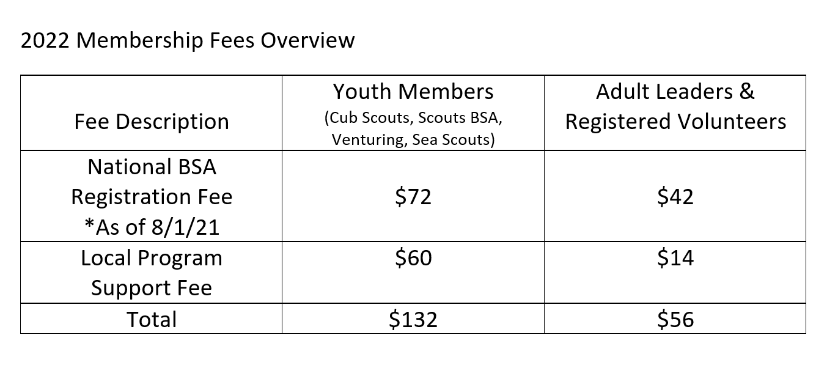
Why 50% popcorn commission?
2022 Program Support fee
$50 new scout enrollment fee and *$12 Scout Life subscription (10 issues)

Slide 15
2022 Program Support Fee
Why is the additional Program Support Fee necessary?
It costs over $300 to keep one Scout in our program for a year.
Unit dues and national registration do not support this cost.

Slide 16
2022 Program Support Fee
Units that sell popcorn and earn a 50% commission will come out ahead this way in the long run.

Slide 17
Where do I start with filling out the Program Planner (calendars & budgets)?
Click on the “Intro” tab, then
“click here to get started”
This will take you to the calendar tab. Start filling in your activities first and then it will pre-populate into your budget

Slide 18
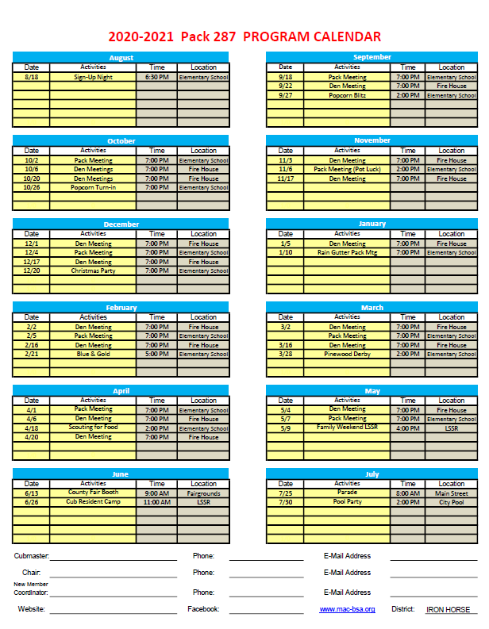

Slide 19
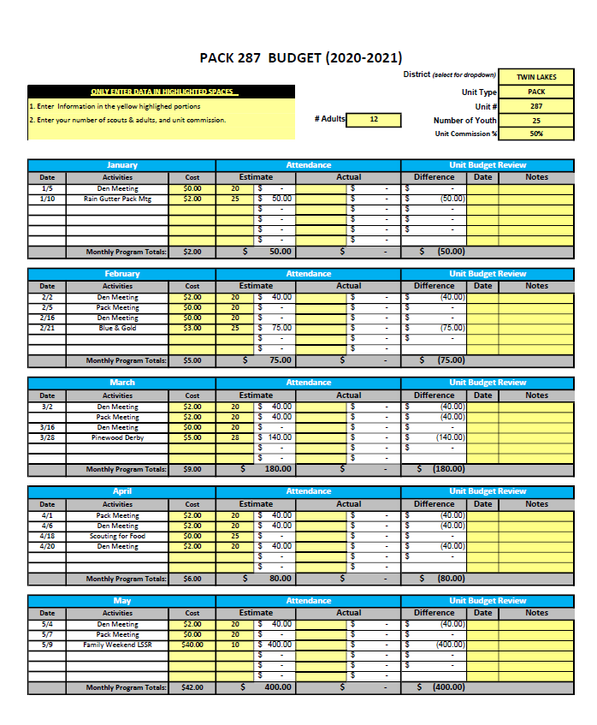
Your activities will be pre-populated into your budget.
Simply you will input your cost per Scout first, then estimated number of Scouts you anticipate.
Monthly subscription plan available.
Notes:
Throughout your year please track your actual attendance to verify you are running on budget with each activity. This budget will help them identify their per scout popcorn goal and to talk to their DE to set up their monthly payment plan via the Council online resource introduced last year.

Slide 20
Train Your Leaders

Slide 21
Training
Every Scout deserves a trained leader!
Youth Protection*
Hazardous Weather*
Leader Specific*
BALOO-Basic Adult Leader Outdoor Orientation
IOLS-Intro to Outdoor Orientation*
Wood Badge
Powder Horn
*required
Online training is available at my.scouting.org and for more information on the supplemental trainings offered go to http://www.mac-bsa.org/calendar.aspx

Slide 22
Assess
JTE from a national level is not being tracked moving forward
IYOS guidebook shows “Promise to Parent” unit recommendations
8 simplified recommendations to make your unit strong

Slide 23
IYOS Philosophy
When Scouts have fun, they stay in longer.
When Scouts are active, more parents become active.
When more Scouts and families are active, Scouts invite friends.
A well planned program helps out everyone

Slide 24
If you get stuck along the way…
Visit the council website https://mac-bsa.org/scouting-tools/iyos/
Contact your Unit Commissioner OR
your District Executive

Slide 25
Due date for calendars and budgets
Calendar and budgets are due June 30 to your District Executive

Slide 26
Questions?

