Slide 1
2021-2022 Ideal Year of Scouting (IYOS)
Notes:
In consideration of everyone’s time, I would ask that you hold your questions till the end of the presentation.

Slide 2
How would you like:
A stronger program for your Scouts?
More parental involvement?
More Scouts in your pack or troop?
More Scouts going to camp?
To eliminate-out-of-pocket expenses
Enough money to do all of your activities?
Scouting to be simpler, easier, and more fun?

Slide 3
What is the Ideal Year of Scouting?
Providing a year-round quality scouting program by following the steps in the Ideal Year of Scouting process.
Successfully provide a program “FREE OF CHARGE” to all families.
Provide an “Unparalleled Experience” for scouts.

Slide 4
The Steps to an Ideal Year of Scouting
Plan
Fund
Grow
Train
Recharter
Assess

Slide 5
Plan Your Program

Slide 6
Brainstorming at your unit meeting
What do the Scouts want to do?
Brainstorming can be done at:
Den Meetings
Pack Meetings
Troop Meetings
Have parents watch but not vocally participate
Parents are part of the calendar and budget planning process (next step)
Write down ideas on flip chart or dry erase board.
Notes:
Units should have a 12 month calendar plan. Having 5 outdoor activities is important because we know for a fact, youth join our program to be outside, shoot bow and arrows, go hiking etc.
Service Projects like Scouting for Food are important because it fulfills our promise to parents, teaches our youth the importance of giving back plus shows the community we are here to help.
Packs should have at least one unit activity during each of the summer months to earn the summertime pack award. Day camp in June and resident camp in July are great opportunities for spring recruits to right away get the “outing” in Scouting experience.
Advancement - 1 important milestone is new youth earning and RECEIVING their Bobcat rank within 30 days of joining.

Slide 7
Planning an Entire Year
12 month plan of Unit activities
Pack and den meetings, troop and crew meetings
Advancement opportunities
5 outdoor activities for the year
Service projects
Popcorn sales/camp cards
Membership recruitment
Day Camp, Camp Amikaro, weekend camping
Resident camp
High Adventures
District/Council activities
Blue and Gold / Court of Honors
Notes:
Leaders/parents then take the Scouts’ suggestions and work as many of them as they can into planning the program, adding that it may take a bit of creativity such as Going to Disney World may become a Mickey Mouse themed B&G. They also need to make sure that the elements listed are incorporated, even if the Scouts forgot to mention some of these items.
Blue & Golds should be held in February as we celebrate Scouting’s Birthday. Rank advancements may not happen at this time if Scouts need until closer to May to finish up Requirements. Don’t forget to include a special Crossover Ceremony for your Arrow of Light Scouts. Troops should be holding a minimum of 3, ideally 4 Court of Honors each year. District Events such as Camporees and District Pinewood Derby should also be included!

Slide 8
Present families with your unit calendar
12 month plan of Unit activities.
Present families with the unit calendar at recruitment events - they want to know what they are getting when they sign-up
Parents need to know what to plan for, financially and scheduling
Increased participation
Better retention

Slide 9
Fund Your Program

Slide 10
Fund Your Program
Use the unit program planner sheet on the Mid-America Council web page https://mac-bsa.org/scouting-tools/iyos/
Plan your budget – include pack/troop/crew/ship expenses and activity costs.
Utilize the popcorn campaign and camp card program
Notes:
“Be sure to enter your cost for each activity as a PER SCOUT cost! (So an event that charges a flat fee should be divided amongst the number of Scouts you expect to attend). Enter your estimate on camp cards you will sell and your overall unit popcorn goal. Scout goals can be calculated by dividing this number by the number of Scouts you have. Be sure to list any anticipated funds received through additional fundraisers in “other income” at the bottom right as well as unit fees.

Slide 11
Fund Your Program
Camp Card Program is March Roundtable – end of April
$2.50 unit commission per card

Slide 12
Fund Your Program
2022 popcorn campaign is September 9- through October 28
50% commission on in-person
40% commission online

Slide 13
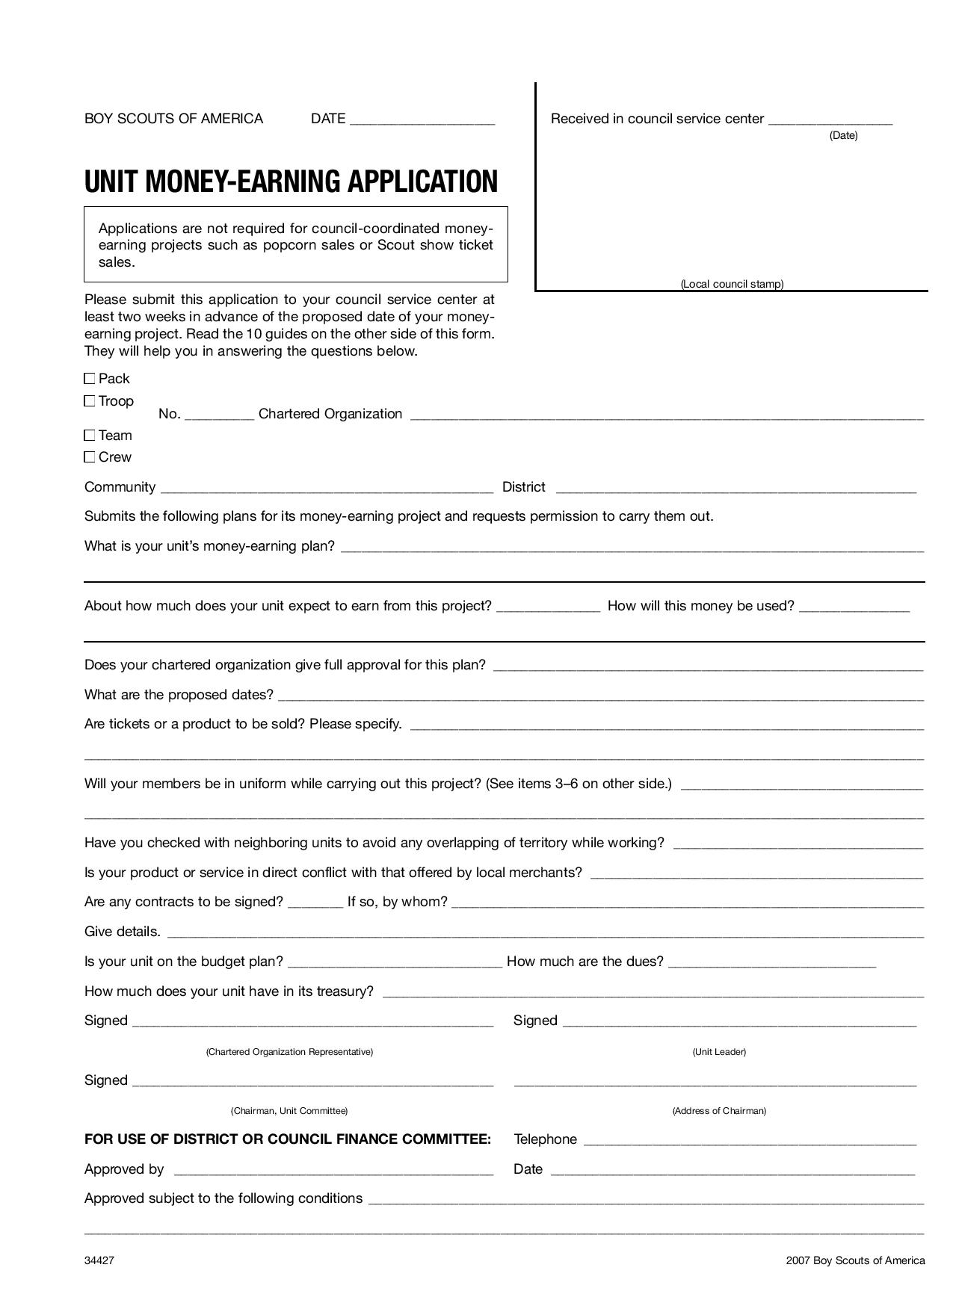
Notes:
Additional fundraisers are fine, as long as Scouts are not fundraising year round! But Unit’s MUST fill out the Unit Money-Earning Application and submit to their District Executive. No portion of your fundraising dollars go to our Council, it is simply to keep the office informed so they can field calls and questions appropriately.

Slide 14
Where do I start with filling out the Program Planner (calendars & budgets)?
Click on the “Intro” tab, then
“click here to get started”
This will take you to the calendar tab. Start filling in your activities first and then it will pre-populate into your budget

Slide 15
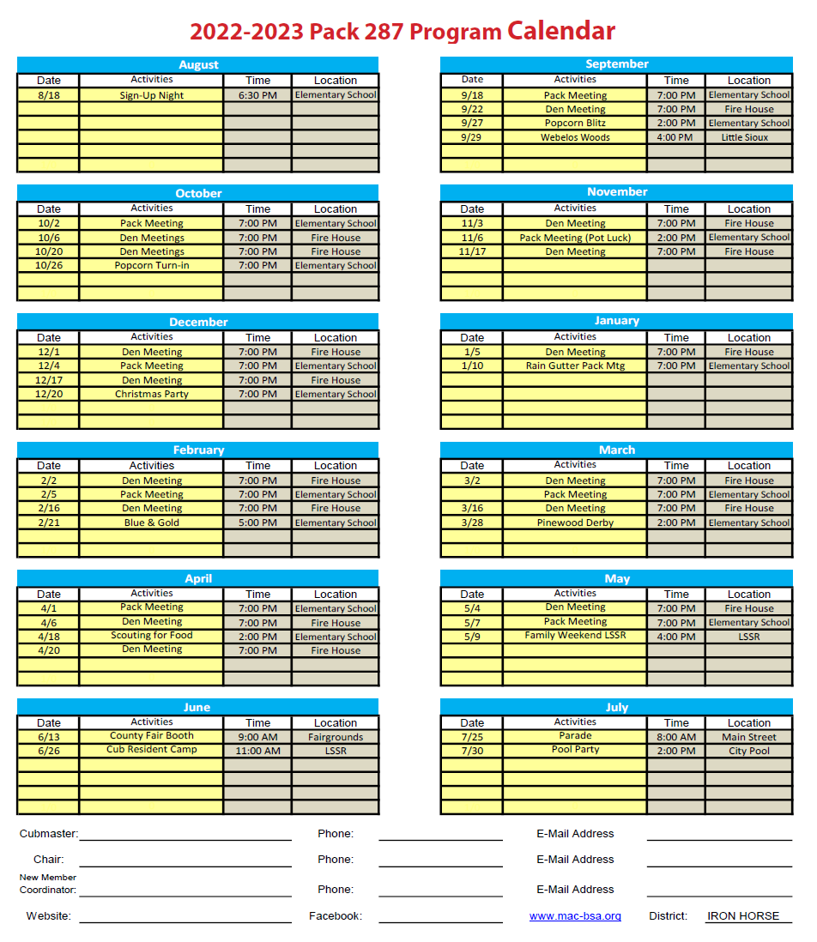
Notes:
This will create a final 12 month calendar you can hand out to new families at your Sign Up Night. Be sure to fill in the point of contacts at the bottom of this page!

Slide 16
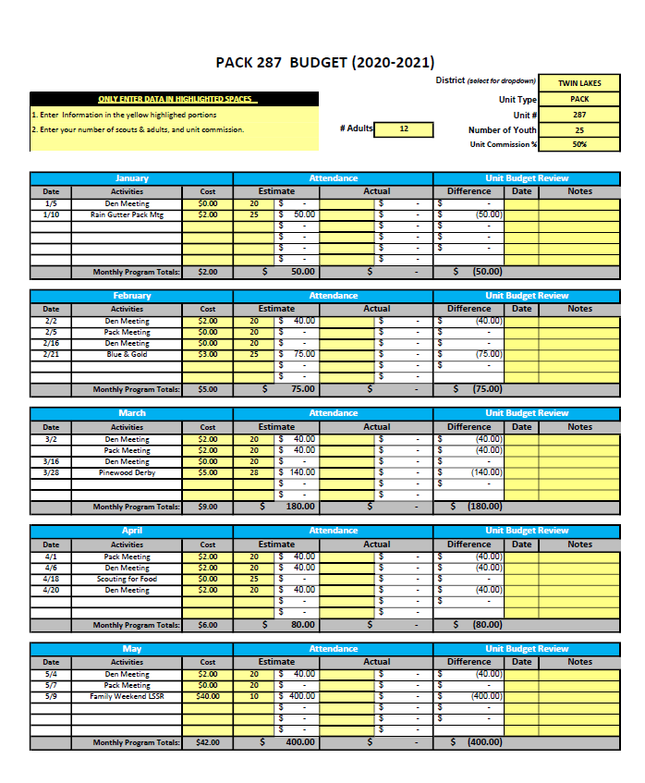
Your activities will be pre-populated into your budget.
Simply input your cost per Scout first, then estimated number of Scouts you anticipate.
Notes:
Again on the budget, remember you activity costs are PER SCOUT! Throughout your year please track your actual attendance to verify you are running on budget with each activity.

Slide 17
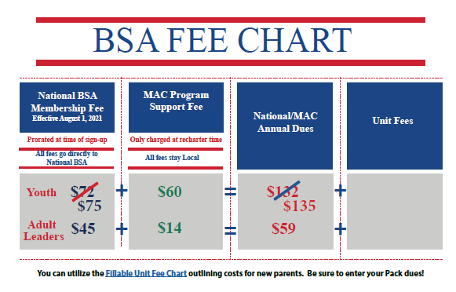
Fund Your Program
Notes:
Please note, National fees will adjust as of August 1, 2022. These amounts will automatically be populated into your budget.

Slide 18
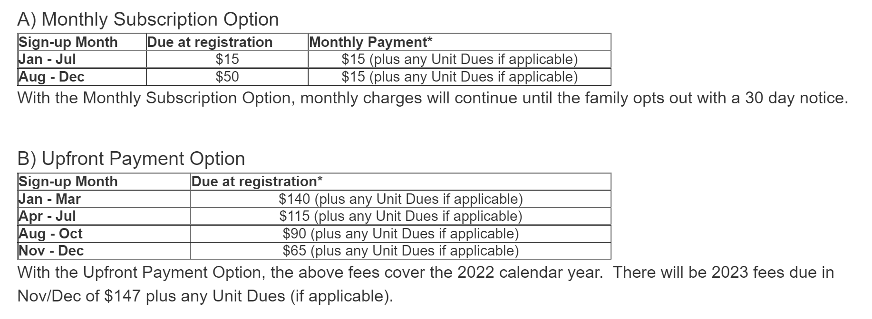
Be sure to email mac@scouting.org with the amount you would like added on for unit fees!
The subscription package includes:
- National BSA Membership Fees
- Local Council Program Support Fee
- Scout Handbook^
- Monthly Scout Life Magazine
Notes:
To keep Scouting affordable and to lessen the burden of chasing down fees, our Council offers a monthly subscription plan. You should identify the amount you want charged for unit dues by emailing mac@scouting.org. The unit fees will be deposited into your UDA as payments are made. You can have these funds transferred from your UDA to your regular banking account at any time upon your request.

Slide 19
Grow Your Program

Slide 20
Grow your Program
Recruit new youth year round
Recruit new adults and leaders
Unit succession plan for all leaders
Order membership supplies:
www.tinyurl.com/MACMembershipSupplies
Notes:
Year round recruitment is necessary to continue growing our program. You should develop a customize membership plan based on your opportunities and school access level. Keep in mind, a recruitment campaign will need to encompass multiple avenues of getting your message out. Utilize a facebook fan page to promote Scouting to potential families.

Slide 21
Train Your Leaders

Slide 22
Training
Every Scout deserves a trained leader!
Youth Protection*
Hazardous Weather*
Leader Specific*
BALOO-Basic Adult Leader Outdoor Orientation
IOLS-Intro to Outdoor Orientation*
Wood Badge
Powder Horn
*required
Online training is available at my.scouting.org and for more
information on the supplemental trainings offered go to
http://www.mac-bsa.org/calendar.aspx
Notes:
Keep in mind, every 2 years Youth Protection Training and Hazardous Weather is required for all registered adults. In addition, direct leader training is part of our Promise to Parents (Cub Master, Den Leaders, Scoutmaster, Assistant Scoutmasters). Be sure to check on the training of your adults through my.scouting.org.

Slide 23
Re-Charter Your Unit
Notes:
Rechartering is an excellent time to plan a presentation to your Chartering Organization. Once processed in mid-February, print your Charter Certificate to present. Also provide a recap on the great things your unit has been doing throughout the year.

Slide 24
Re-Chartering
Each year, every unit in the Council must re-charter by November Roundtable
Make sure your charter is submitted with all signatures
100% Youth Protection Required
Unit Inventories will take place in the Fall (around September/October)
Recharter payments are due at December Roundtable!
Notes:
Sometimes there are missing pieces to your Charter, that lingering youth protection or a missing birthdate on an application. These MUST be corrected before your Charter can process. Submitting by November Roundtable ensures our registrars have time to check submitted recharters and provide notification of any overlooked items. Keep in mind that EVERY unit, over 500 in our Council, submit at that same time and it takes time to go through each and every one with a fine tooth comb!
If your Charter does not fully process by December 31…you unit is in jeopardy of not being recognized as a Boy Scouts of America entity. This means you may be opening up your Chartering Organization as well as yourself personally, for liability issues if something were to happen and not be covered by BSA blanket insurance policy.

Slide 25
Assess Your Success

Slide 26
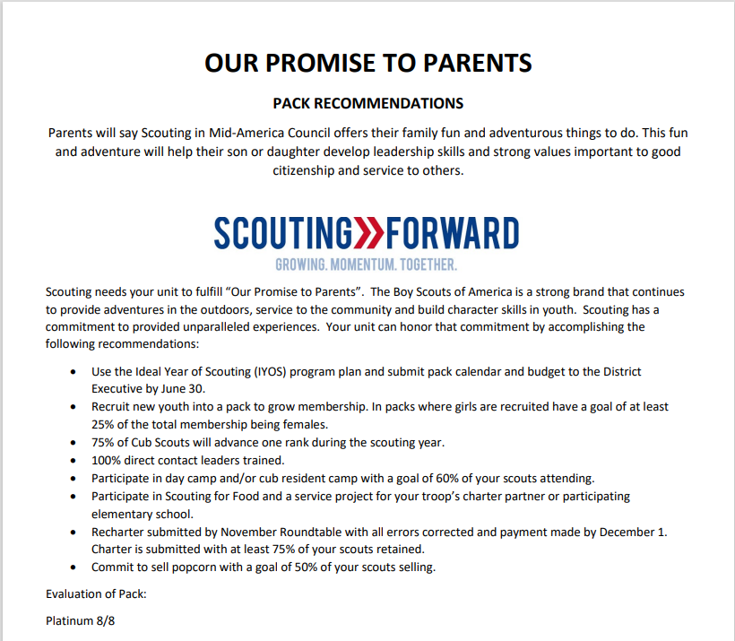
7/8 Gold 6/8 Silver 5/8 Bronze
Notes:
Notate there are specific Promise to Parents for to each type of unit, Pack, and Troop. This assessment tool coincides with the program year running from Aug 1 – July 31.

Slide 27
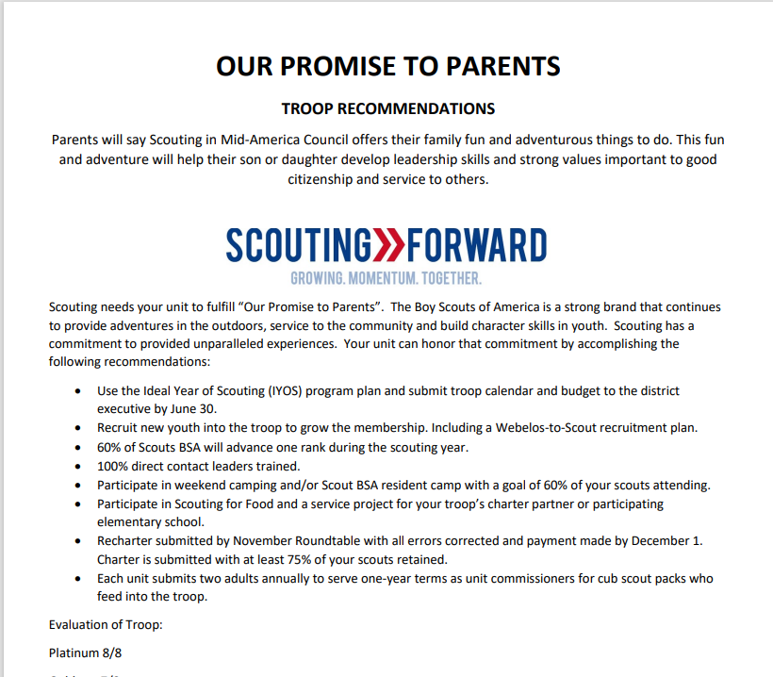
Notes:
These reports are handed out at Roundtable on a quarterly basis. Keep in mind, some of the criteria will not reflect until closer to the end of the program year.

Slide 28
Adjust information on your quarterly
Promise to Parents through the self assessment tool
www.tinyurl.com/P2PSelfReport
Fulfilling our Promise to Parents starts with the Ideal Year of Scouting!
Notes:
If you feel the information in these reports is inaccurate, be sure to utilize the self reporting tool to correct.
Follow the steps outlined in the Ideal Year of Scouting to ensure we fulfilling our Promise to Parents.

Slide 29
IYOS Philosophy
When Scouts have fun, they stay in longer.
When Scouts are active, more parents become active.
When more Scouts and families are active, Scouts invite friends.
A well planned program helps out everyone

Slide 30
If you get stuck along the way…
Visit the council website
https://mac-bsa.org/scouting-tools/iyos/
Contact your Unit Commissioner
OR your District Executive
Notes:
Be sure to also check out the Ideal Year of Scouting Guides for more in -depth information and digital links to resources.

Slide 31
Due date for calendars and budgets
Calendar and budgets are due June 30 to your District Executive
and 1:1’s for Packs
Notes:
And Packs, don’t forget to schedule you 1:1 meetings with your District Executives by June 30th. Troops are welcomed to do so as well!

Slide 32
Questions?

