Slide 3
Membership fees/dues
Camp fees
Pinewood Derby
Uniforms
Meeting materials/supplies
Blue & Gold
Campouts
Patches & Awards
Unit Adventures/outings
Youth Leadership Training
National Jamboree
Unit equipment
Camp/Council facility Upkeep
Service Projects
Trail’s End Rewards (Amazon gift cards)
Notes:
Scout personal benefit:
Personal growth that can also be applied to advancement opportunities and service projects.
Amazon.com gift cards, Council incentives, district incentives, unit incentives, lower family out of pocket program
Learning experiences:
Help others around them.
Public speaking
Salesmanship & perservance
How to earn their own way
Goal setting and how to achieve those goals
Being apart of something BIGGER than themselves. (Scouts to den/patrol, to unit, to district, to council, to the Scouting movement.
Funding:
What did your Unit include in their Ideal Year Of Scouting plan? The options are endless and should/can be including when you’re talking about what the Scouts/families get out of the fundraiser.
Include a slide that is specific to your Unit and families.

Slide 5
A Successful Sale
Notes:
Scouts should practice their sales pitch! Encourage Scouts to pair up with a friend or family member. For kickoff, it is great and highly encouraged to have your more experienced/willing Scouts to come to the front for a “skit”. It’s ok to have a bit of fun and do an example of “bad” and “good” pitch.
- Direct your Scouts to their Training Tabs for advice from national top sellers.
-

Slide 6
A Successful Sale
Notes:
Just like we want Scouts to practice their sales pitch, don’t forget to prepare for your kickoff. Work with other leadership or parents to assist. Be prepared with your “per Scout” and overall “Unit” goal.

Slide 8
Ways to Sell
Notes:
All of these are available through the app. Each Unit will be different on how they set up storefronts (& shifts), wagon – does your Unit have wagon bundles, take order only, etc.?

Slide 9
2022 Trail’s End Tech

Slide 10
Unit Leader Portal
The Unit Leader Portal is now mobile friendly where Units can access the portal while at a storefront or on the go.
Units can manage their entire sale from their phone.
Use Chrome, Safari, or Firefox
Some Unit Leaders recommend adding/saving a shortcut icon to the login screen for convenience.

Slide 11
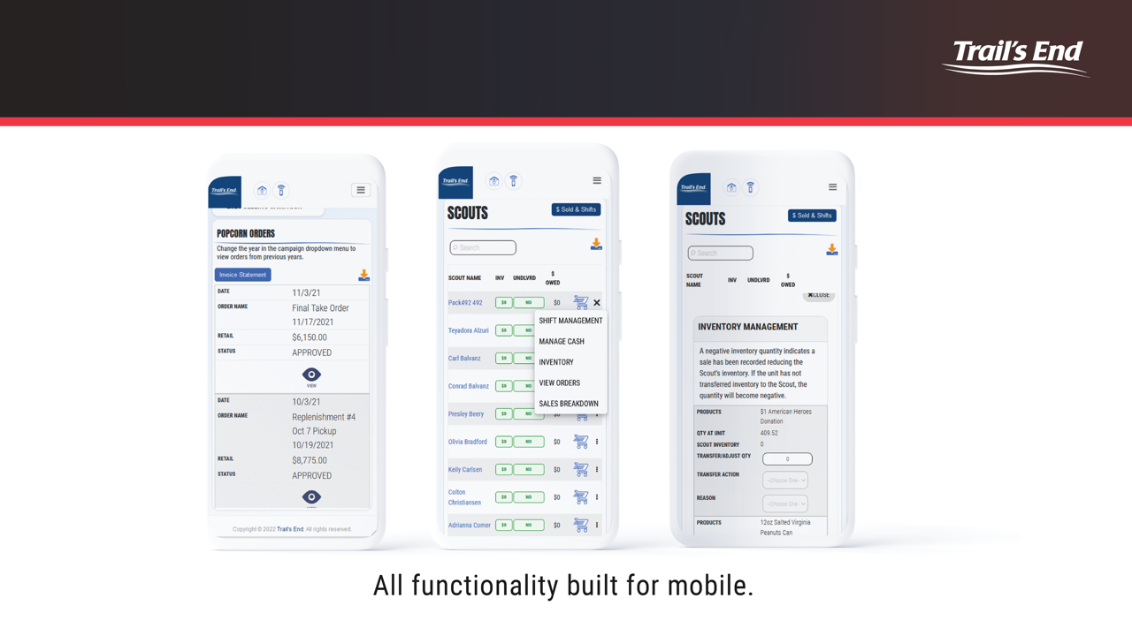
Unit Leader Portal
Notes:
Some Unit leaders find it easiest to save a short cut to their TE login on their phone, which makes it as easy as an app.

Slide 12
Trail’s End App
Notes:
The Trail’s End App is for Scouts only. This will communicate directly to your Unit Leader portal that you will access from your web browser (Chrome, Safari, or Firefox).
If Scouts don’t have access to the app, they can always use the order form, then enter when they get home online by logging in. Note – credit card payments can only be recorded through the app.

Slide 13
Trail’s End App
Notes:
Recommended to have c type adapters if using swipe readers. Most recommended – Bluetooth reader for more payment options. Remember not to instruct parents/Scouts not to login into Square, all sales need to be rung into TE app with the Scout logged in. Users MUST allow app permissions for sales.

Slide 14
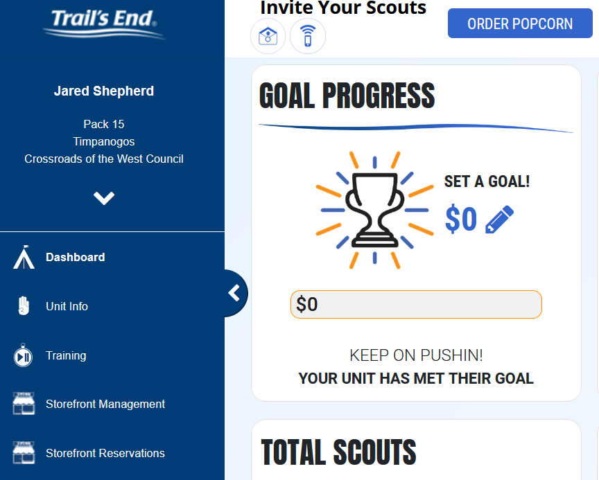
Trail’s End Storefronts

Slide 15
Storefronts – set up
Whether you’re entering Unit booked stores or reserving TE booked stores, be sure to set your Storefront Settings to save yourself time!
To enter storefront information and shift times, go to Storefront management.
For a step-by-step ‘How To’ guide to setting up storefronts, go to
https://mac-bsa.org/scouting-tools/popcorn/storefront-how-to/
Notes:
If using the storefront reservation system, please see the Storefront reservation guide for full details. With storefront reservations, you will set “storefront settings” > “storefront reservations” (to reserve store slots) > then manage in “Storefront Management”.
Please note TE booked stores are being piloted in BH, IH, & WW. Outlying Units (in districts outside the 3 mentioned), will see and have the opportunity to claim/work these hours once they open up outside of the districts (starting 8/19).

Slide 16
Storefronts - Scouts
Scouts will manage their storefront shifts and sales through their app!
“Storefront” tab
Once you have set up stores/shifts in Storefront management, Scouts will be able to view available stores/dates/shifts
Shifts will become available for the Scout to “claim” on the date and time selected in the Unit Leader Portal.
If the app doesn’t automatically open up to their shift, they will select “sell” on the CORRECT shift.
All sales will directly record to the shift selected.
RED dates indicate the all slots are full
Encourage Scouts/parents to login ahead of their shift.
Notes:
Scouts will view, sign up/withdraw, and sell –ALL in the “Storefront” tab.
Please note, if a Scout selects the wrong shift and records sales, the sales can be moved/corrected from the Leader Portal.
We recommend going through an overview of selling before Scouts head to their storefronts.
Encourage Scouts/parents to login ahead of their shift to ensure they know their login credentials.
Include a “App guide” in your Storefront binder for quick reference if needed.
Include a paper form in your storefront binder, but ensure Scouts/parents know that is for back-up ONLY! Phones die, get dropped, no cell signal, etc. it’s better safe than sorry.

Slide 18
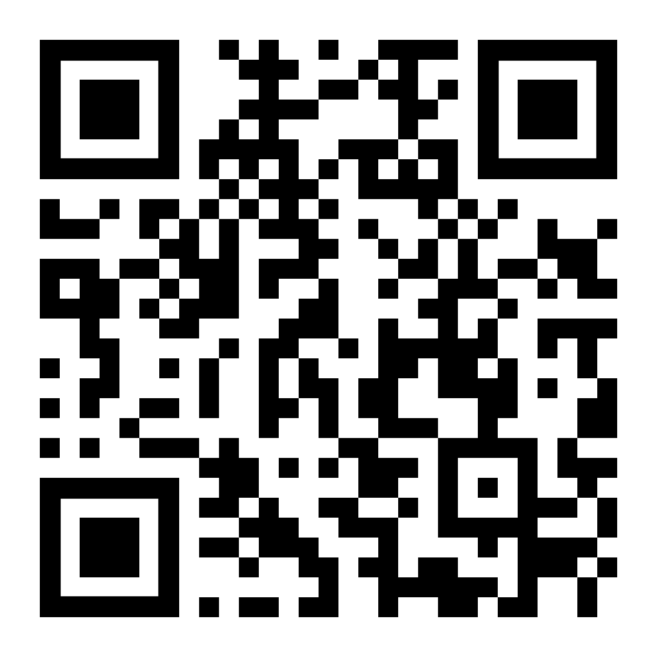
Trail’s End Webinars
View the webinar video(s) when it works for you!
Videos have been recorded and are available in the “Training” tab of your Unit Leader Portal.
NEW! “Open Office Hours” on Trail's End Popcorn Community FB group at 7pm, on Wednesdays, Starting 7/29.
For more Open Office Hours information,
go to https://www.trails-end.com/webinars

Slide 22
Economic Factors
The BSA National Council is implementing a licensing fee on all product sales. In 2022, popcorn companies are having to collect $0.50 per container. This will result in an increase on the retail price of the product. This fee will be accessed on traditional sales and online sales. The fee will apply to physical items only; American Heroes & Helpers / military donations are exempt. Inflation to corn, oil, cardboard, shipping, fuel, etc
The opening price point of $5 in 1980 equates to an opening price point of $16.98 in 2021.

Slide 24
Traditional Products
$30
$25
$17
$45
$25
$22
$15
$25
Notes:
Chocolate pretzels will not be available during initial orders, but will be available for replenishments. Scouts can still sell/track chocolate pretzels (or any product) and marking “undelivered” until available to deliver.

Slide 25
Additional Online Products *
Agenda
* Providing supply chain issues are minimized
Notes:
Remember Online prices are subject to change and may be more or less than Council selected traditional prices.
Shipping has been simplified compared to years past, based off of Council, Leader, Scout, and consumer feedback. Shipping cost for orders UNDER $70 is $13.99 (excluding microwave and popping corn – these have additional $3 fee).
Orders $70 and OVER is FREE (with the exception off microwave and popping).

Slide 26
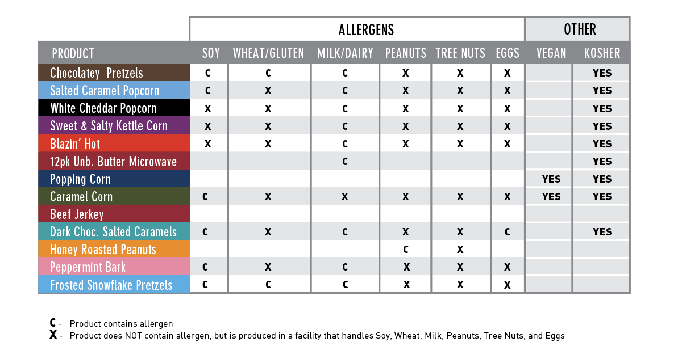
2022 Product Allergens
Notes:
New helpful resource available in the Training tab of both Leaders and Scouts. We recommend having in your Storefront binder for quick reference, if needed.

Slide 28
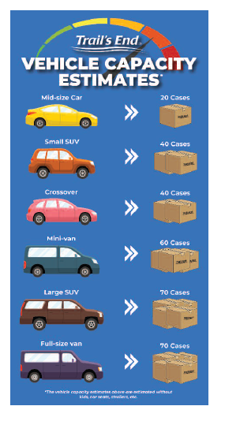
Ordering

Slide 30
Unit Initial Orders
Initial Orders
Initial orders are open now!
Unit Orders due 8/24 at NOON
Units can order up to 100% of last year’s sales
NEW selling Units: Contact your DK/DE about goals, plans, etc. to get initial ordering $ max. Note: Best to have IYOS plan info. handy.
Pick Up Information:
Please check with your District Kernel about your district specific location

Slide 31
Unit Replenishment Orders
Metro Replenishment dates will be OPEN to ALL districts to pick up at the Omaha warehouse.
Pick Up location: (NEW LOCATION)
R&R Commerce Park
14910 Gold Coast Road
La Vista NE 68138
Place your replenishment order on www.trails-end.com, click “Order Popcorn” and submit by Sunday at 7PM
Any reservations not picked up by 7:00PM will be canceled and re-entered into the council’s general inventory. A new order would be necessary for the next pickup date
NOTE: Outlying Districts will have October replenishment delivery at October Roundtable with orders due by 10/2.
Order Due | 9/11 | 9/18 | 9/25 | 10/2
Order Pick Up | 9/15 | 9/22 | 9/29 | 10/6*
Notes:
Units outside metro will not have to do any special requests for replenishment in metro, they will be available in the Unit orders.
Note, these (9/15, 9/22, 9/29) are pick ups at the Metro warehouse.
Outlying districts will have October replenishment orders delivered and available to pick up before Roundtable in October (10/4 & 10/6 depending on district).

Slide 32
2022 MAC – New to the Sale!
Amnesty Policy
September 29th (Please check with your district – date/time/place )
Units can return resellable cases (open or unopen) without it counting against 10% return max.
No stickers, writing, damaged product, etc.
Do NOT enter in the TE system; amnesty returns will be entered on the back end.
No chocolate will be accepted
New Return Policy
Can be “refilled” cases but MUST be same product
Up to Council discretion
No stickers, writing, damaged product, etc.
No chocolate will be accepted
10% of total pre-orders (initial order + all replenishments)
Trail’s End Reserved Storefronts
Metro Pilot – stores booked in BH, IH, WW
Stores will open Council wide on 8/19. Units outside the metro are welcome to reserve/work these stores once they are released Council wide – please reach out for more information if you are interested
Expansion/changes for 2023 will be discussed based on 2022 Unit feedback.
Notes:
Metro amnesty will be held at the new storage location.
Districts outside the metro will vary – please relay your district specifics.
Storefront reservation guide can be found in the Training tab of your leader portal and will be uploaded to https://mac-bsa.org/scouting-tools/popcorn/

Slide 33
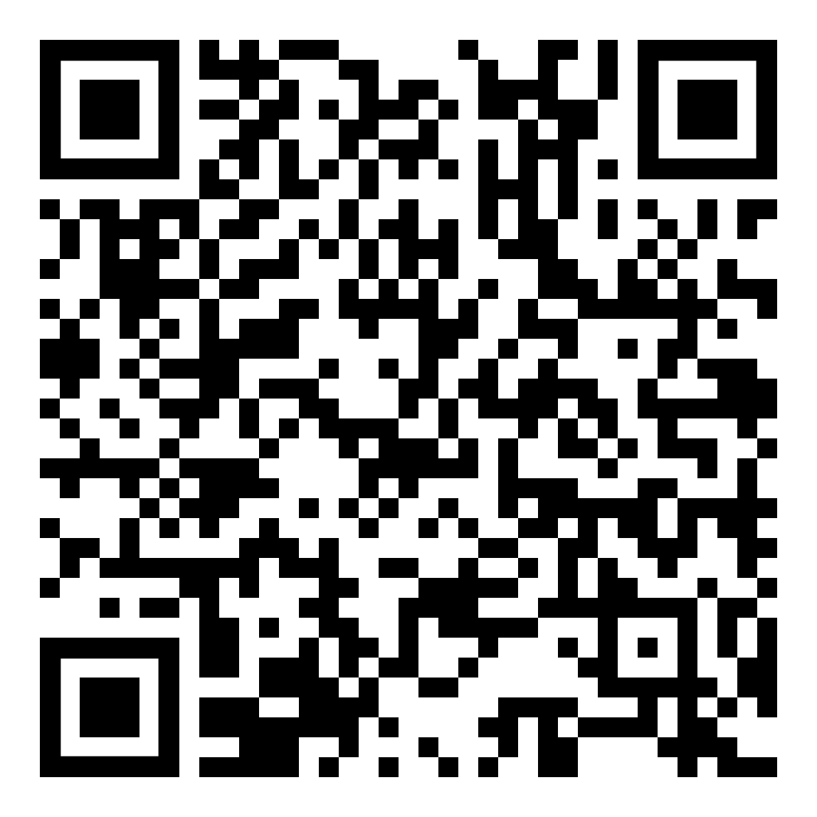
2022 MAC Dates
Full schedule pdf HERE or follow the QR.

Slide 34
2022 MAC Dates

Slide 35
2022 MAC Dates & Returns
RETURNS:
Outside of “Amnesty Day”, Units can return UP TO 10% of total orders with no fees (excluding chocolate).
Cases must be FULL but can be open.
Work with surrounding Units to “refill” cases if needed
Accepted returns at Council discretion.
Notes:
Chocolate is NOT returnable at all (including amnesty day).

Slide 36
2022 MAC Commissions
Commission Type: | Commission Percentage:
Traditional | 50%
Online Direct | 40%
How funds are distributed with the Unit, is up to the Unit committee. If you have questions about “what do the Scouts get” or the like, please reach out to your Unit committee.
Units will be able to payout* directly to the Unit OR Council on the account summary tab of the Unit Leader portal.
If directing it through the Council. The money will be deposited to the UDA.
Notes:
*Credit and online sales will be applied to the Unit invoice first, then will be available for payout.
Units paying out “to the Unit” – this is the most automated process. The bank information must be entered into secure bank portion of the “Unit Info” tab in the Leader Portal.
If directing payment to the Council, it will be deposited to the UDA, where it can be used for council fees, Scout shop, membership, etc. OR a Unit may request to withdraw from the UDA to be able to deposit to their Unit bank account.

Slide 37
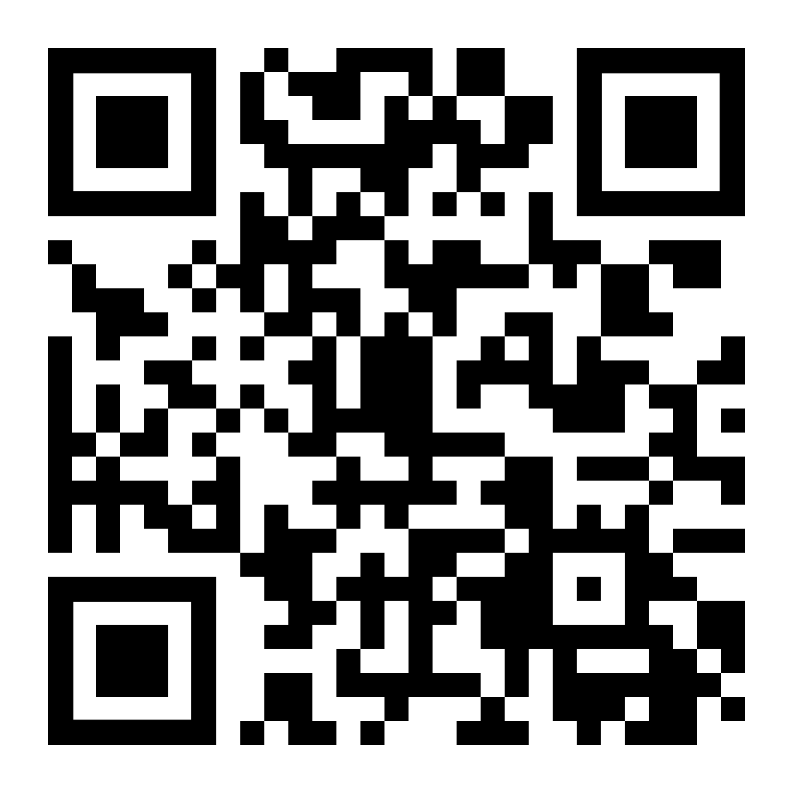
2022 T-Shirt Ordering
2022 T-Shirts available to order!
Adult and youth sizes available
Cotton/poly blend
Cost: $10 each*
Orders Due by 8/16
More details at the link below
Great for (ideas as to who would want them):
Kickoff
Unit Popcorn Team members
Incentives
Parents out with Scouts during selling season
Order HERE or follow the QR
Notes:
Optional for Units to order for your Unit or require parents/Scouts to directly order themselves. Use the link to place your order. The link will also be available on the MAC popcorn landing page.
*sizes XXL+ are $12-$14

Slide 38
2022 MAC Prizes
$1250 Club
Creighton Game (Date TBD)
Food Voucher
Medal
$2000 Club
Creighton Game (Date TBD)
Food Voucher
Medal
T-Shirt
Top 10 Trophies
Participation Patch for all Sellers
Packs – Promise To Parent points
Notes:
See https://mac-bsa.org/app/uploads/2022/03/Pack-Promise-to-Parents.pdf at https://mac-bsa.org/scouting-tools/iyos/ for more “Promise To Parents” details.

Slide 39
2022 District Rewards & Specifics
Please reach out to your District Kernel about your District specific incentives.
Check with your district about any special kickoffs and/or celebrations or events.

Slide 40
Contacts & Resources
Black Hawk District Kernel
Vacant
blackhawkpopcorn@gmail.com
Diamond Dick District Kernel
Regan Rodriguez
diamonddickpopcorn@gmail.com
Goldenrod District Kernel
Chad Adams
goldenrodpopcorn@gmail.com
Iron Horse District Kernel
Lisa Hayford
ironhorsepopcorn@gmail.com
Ohwahnasee District Kernel
Allison Steufert
ohpopcornsales@gmail.com
Petah La Shauro District Kernel
Julie Reiff
plspopcorn@gmail.com
Trailblazer District Kernel
Angie Awe
Angie-awe@hotmail.com
NW Iow District Kernel
Jobina Kirby
kirbygj@yahoo.com
War Eagle District Kernel
Bill Splitter
Williamsplitter@yahoo.com
Wagon Wheel District Kernel
Vacant
wwdpopcorn@gmail.com
Council Kernel
Danessa Hemmer
MACPopcorn360@gmail.com
Council Popcorn Staff Advisor
Tina Douglas
Tina.Douglas@scouting.org

Slide 41
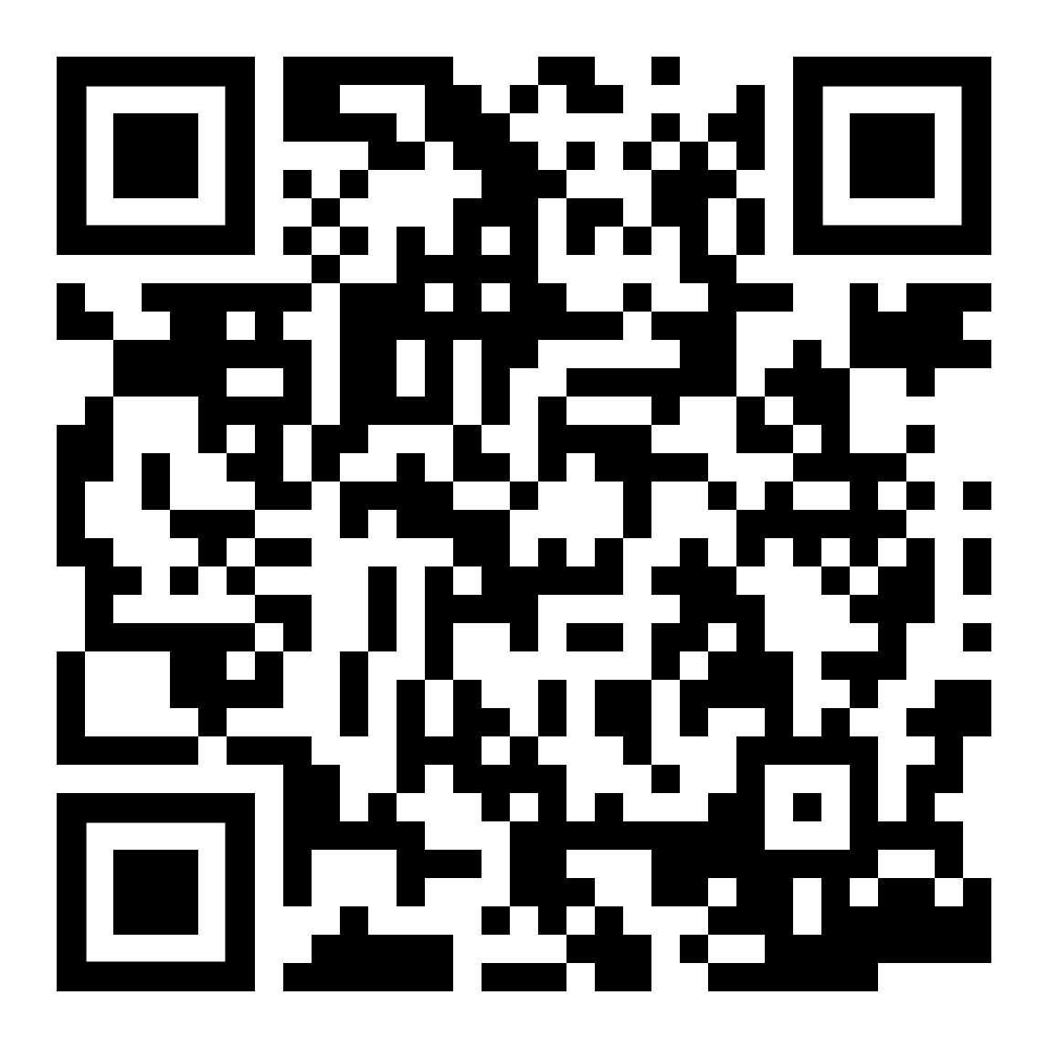
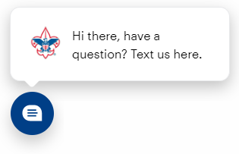
Contacts & Resources
Please visit MAC Scouting Tools >Popcorn for resources for a successful campaign
Mid-America Council Popcorn Facebook group
MAC@scouting.org
Text/chat (402)431-9272 OR from mac-bsa.org

