Slide 1
Wakefield Cub Scout Pack 172
Pack Calendar—If you provide an email,
we will email you the link.
Notes:
Display while parents are filling out applications. Encourage to join FB group and provide email for Pack Calendar.

Slide 2
Our Council and Our District
District FB Page:
“Diamond Dick District, Mid-America Council”
Council FB Page:
“Mid-America Council, Boy Scouts of America”
www.mac-bsa.org
Notes:
Explain to parents how we are part of “larger” groups within scout—city-county-state; unit-district-council

Slide 3
Aims of Scouting
Character Development
Spiritual Growth
Citizenship
Community Service
Leadership
Being part of team
Personal Fitness
Outdoor Activities
Notes:
When you think of scouting, these are some things we just “know” about scouts.

Slide 4
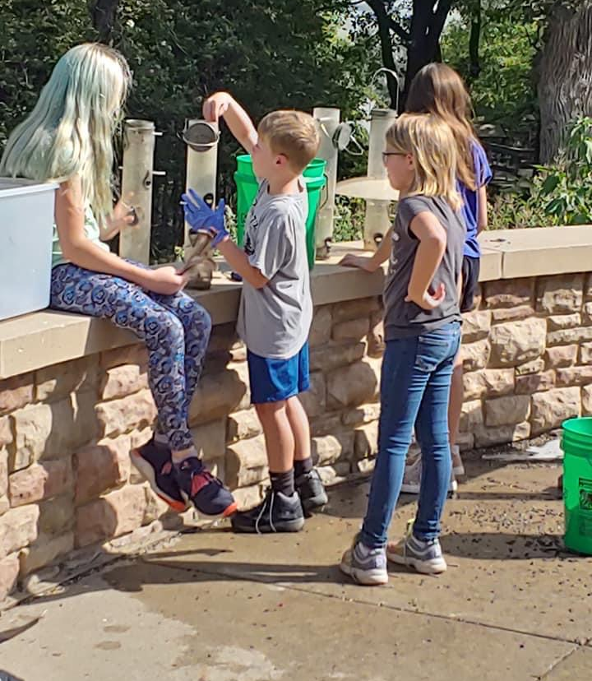
Pack 172 Community Service
Flag Raising at School
Memorial Day Crosses/Flags
Legion Steak Feed
Parade Help
Scouting for Food
Conservation Projects
Care Center Christmas Caroling
Notes:
Specifically, Pack 172 has been involved in a variety of community service throughout the years.

Slide 5
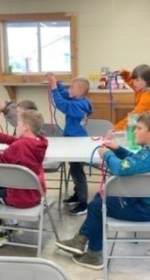
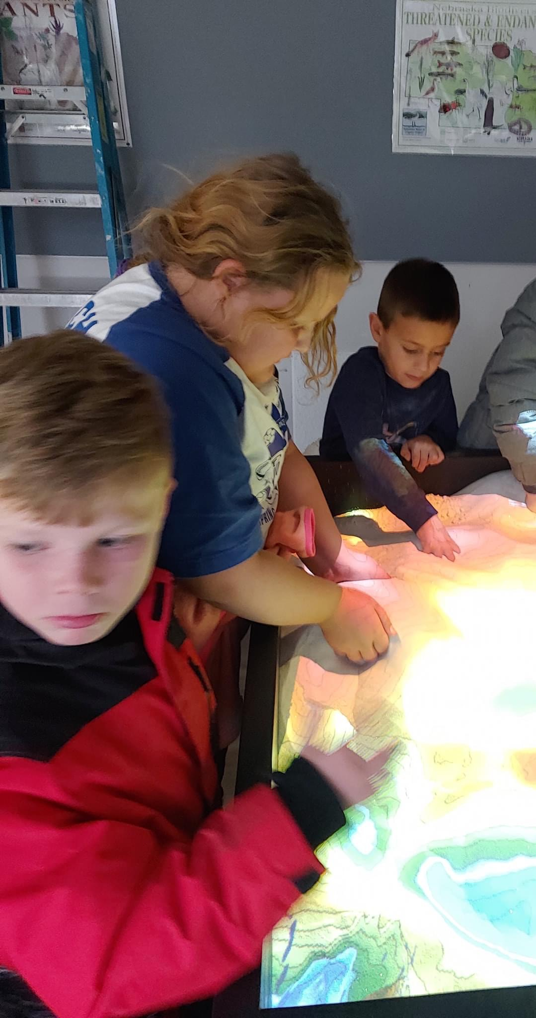
Pack 172 Special Outings and Events
Christmas Party
Pinewood Derby
Planetarium
Sports Games
Campouts
End of Year Party “Blue Gold Banquet”
Notes:
Here are some of the FUN and amazing experiences our scouts get to participate in.

Slide 6
PACK
Cub Scouts Organization
Den
Bear
Den
Webelos
Arrow of Light
Lion
Tiger
Den
Wolf
Den
Den
Den
1st Grade
2nd Grade
3rd
Grade
4th Grade
5th Grade
Kindergarten
Notes:
Cue Slideshow here! The various dens are divided by grade level (or age level for homeschool). Direct parents to fill in postcard.

Slide 7
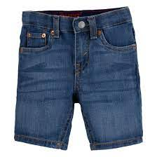
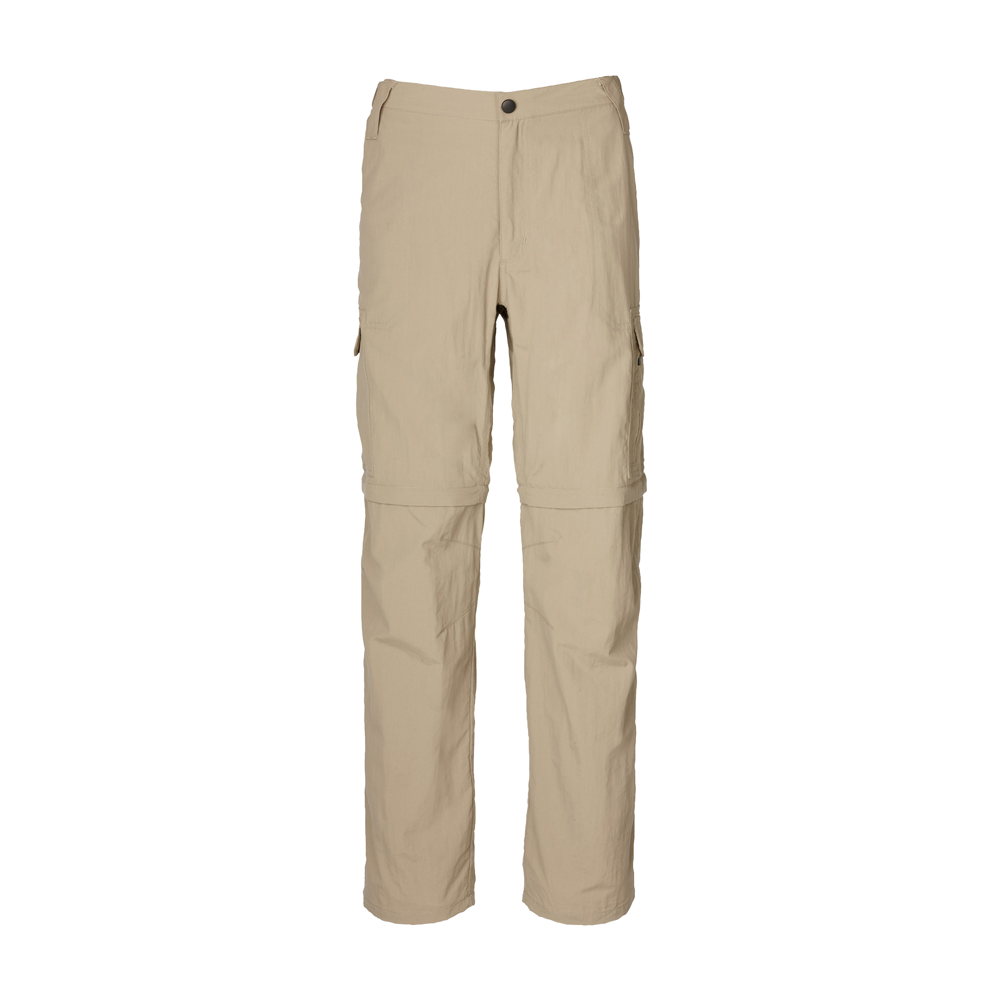
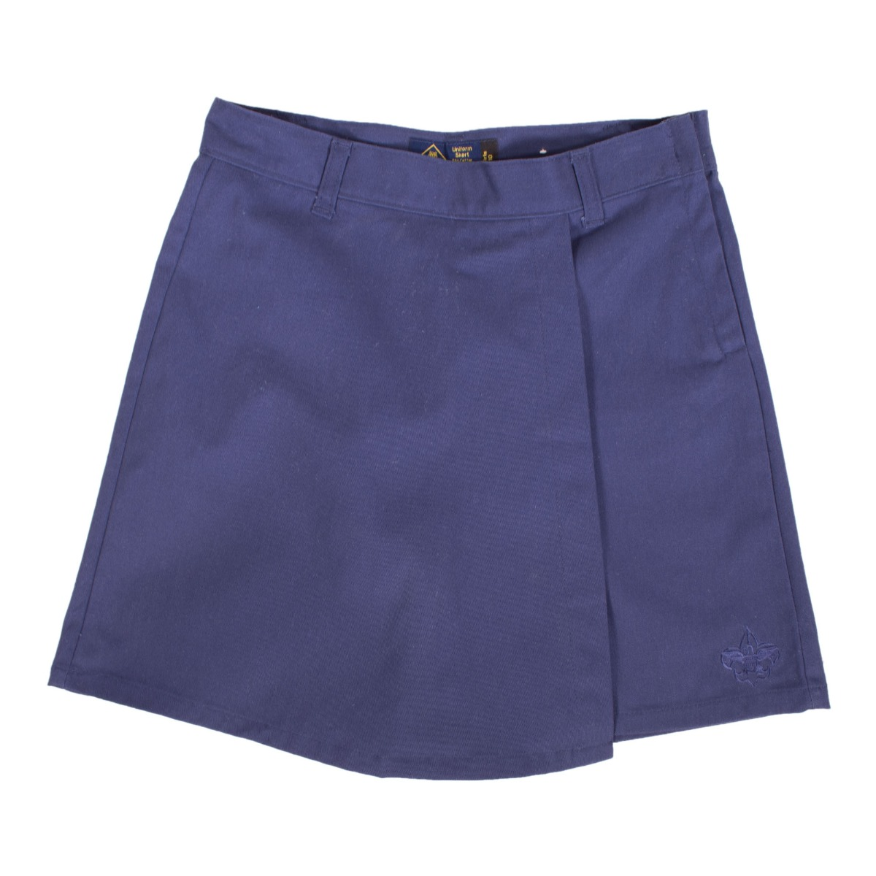
Pack 172 provides all patches, neckerchief, slide, belt, belt loops, and all other awards.
Parent provides official Lion T-shirt and a pair of good pants, shorts, or skirt.
Notes:
Emphasize that it’s only the OFFICIAL shirt that parents really need to worry about.

Slide 8
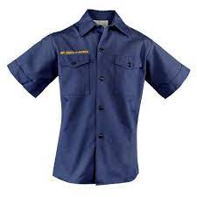
Pack 172 provides all patches, belt, neckerchief, slide, belt loops, and other awards.
Parent provides official navy shirt and a pair of good pants, shorts, or skirt. Book depends on den leader preference.
Notes:
Again, emphasize that it’s only the OFFICIAL shirt that parents need to get.

Slide 9
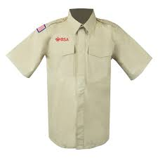
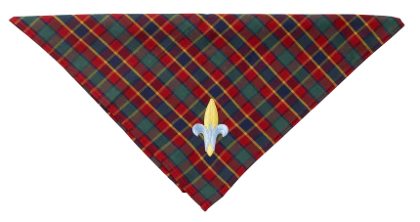
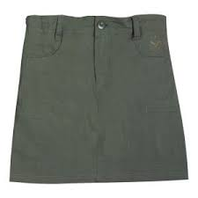
Pack 172 provides all patches, Webelos colors, shoulder loops, neckerchief, slide, book, pins, and other awards.
Parent provides official khaki shirt and pair of good pants, shorts, or skirt.
Notes:
Again, emphasize OFFICIAL shirt ONLY! Direct parents to fill in postcard. Highlight coupon for official bottoms in packet.

Slide 10
Lion (K) and Tiger (1st) Dens
Lions and Tigers are required to have a parent or another trusted adult with them for all activities.
Lion Den Leader is..…Lisa Sievers
402-369-1168
snlsievers@gmail.com
Den Chief is Oliver, Scout from Troop 172B
Tiger Den Leader is…..Lisa Sievers
402-369-1168
snlsievers@gmail.com
Den Chief is Kristalyn, Scout from Troop 172G
Notes:
Parents will fill out their post card with leader info.

Slide 11
Wolves (2nd) and Bears (3rd)
Wolves and Bears work on expanding their scouting skills! Parent supervision and volunteering are highly encouraged!
Wolf Den Leader is…..Jason Jensen
402-336-6061
Jason.c.Jensen@outlook.com
Den Chief is Asher, Scout from Troop 172B
Bear Den Leader is…..Krista Roeber
402-518-0137
roeberkrista@yahoo.com
Den Chief is Jaden, Scout from Troop 172B
Notes:
Parents will fill out their postcard with leader info.

Slide 12
Webelos (4th) and Arrow of Light (5th)
Webelos and Arrow of Light Cubs work toward preparing to join Scouts BSA (big kid scouts!)
Webelos and Arrow of Light Den Leader is…..
Michelle Mark
402-369-6777
ddcampingchair@gmail.com
Assistant Den Leader is Lindsay Meeks
Notes:
Parents will fill in leader info on postcard.

Slide 13
Cost of Cub Scouting
Campouts
Registration Fee—Make check out to Pack 172 or Setup Online
$90 today and $147 again in November (local payment) or $50 today with monthly payments of $15/month (online option only)
$15-$50 at Scout Shop depending on what den your child is in
$15 for Official Lion T-shirt
$30 for Official Navy Blue BSA Shirt—Tigers, Wolves, Bears
$50 for Official Tan BSA Shirt—Webelos
$30 today—You’ll get a Pack T-shirt and uniform belt at first den meeting!
Official Uniform Shirt—Sioux City Scout Shop, Gottschalk Scout Shop (Omaha), Community Online Facebook Sites, borrow/buy from friend, or you can check with us to see if we have the right size for you!
Pack Dues—Make separate check out to Pack 172
Food and Snacks
Awards
Service Projects
Notes:
**Sometimes the Scout Shop has discontinued styles of shirts that are cheaper!

Slide 14
Ways to Pay for Scouting—Do NOT let the cost stop you from signing up! We will find a way!
Registration Fees
WellCare of Nebraska
Mid-America has Scholarships
Uniform—The official SHIRT is really all you need to go buy or find!
Borrow or Buy from your neighbor, scour the online sales sites, or check our supplies for the right size for your kiddo
The Scout Shop sells lots of fun extras—socks, hats, shorts, skirts, pants, hair bows, etc. These are NOT required in Pack 172, but you may purchase them if you’d like.
Do NOT buy any patches, numbers, belt loops, insignia, etc. We provide all that at no cost.
Popcorn Sales can also help pay these things as your scout grows or needs additional items.
Camp Card Sales—help pay for camping opportunities
Popcorn Sales--Pack 172 sells popcorn to help families pay for the $147 fee in November and for uniform updates, etc.
Notes:
Most families sell enough popcorn to pay for the November fee. The online option is new.

Slide 15
Meetings are 2nd and 3rd Sundays
at the Wakefield Evangelical Covenant Church
2nd Sundays of the Month
5:00-6:30pm—Tiger, Wolf, Bear, Webelo, and Arrow of Light Dens meet for DEN Meetings.
No Lion Den these Sundays
3rd Sundays of the Month
4:00pm—Lion Den Meets
5:00-6:30pm—Tiger, Wolf, Bear, Webelo, and Arrow of Light Dens meet for PACK Meeting.
Lions leave at 5:30pm after Pack Meeting. Everyone else stays for their den meetings.
First Meetings:
Sept. 11 at 4pm—Parent Orientation Mtg.
Sept. 11 at 5pm—Tiger, Wolf, Bear, Webelo, and Arrow of Light Den Meeting
Sept. 18 at 4pm—Lions have their first meeting
Sept. 18 at 5pm—Tiger, Wolf, Bear, Webelo, and Arrow of Light join Lions for 1st Pack Meeting
Notes:
Direct parents to write down the date of their child’s first den meeting.

Slide 16
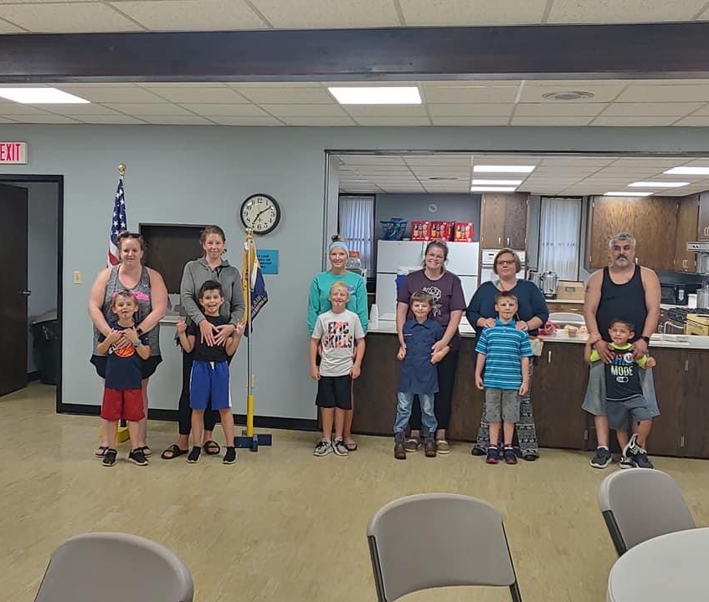
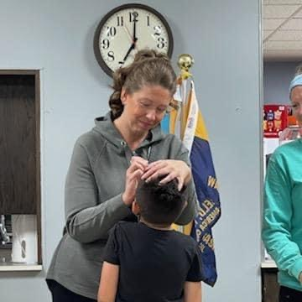
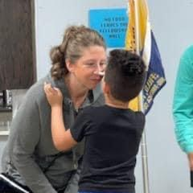
New Scout’s First Rank: Bobcat
The Bobcat Badge is the first rank for Tiger, Wolf, Bear, Webelo, or Arrow of Light Scouts to earn.
It teaches Cubs and their adult partner the basics of Scouting.
The Bobcat Ceremony is usually the first special ceremony a Cub and their adult partner participate in.

Slide 17
Next Steps
Finish Youth Application and pay fees—please inquire privately if you need assistance with fees. We really CAN help!
1
Get Official Shirt for your Cub—Sioux City Scout Shop, Gottschalk Scout Shop in Omaha, or other means
2
Attend Parent Orientation on September 11 at 4pm. Bring your Cub with you because most den meetings follow at 5pm!
3
Invite friends you know are interested to our Make-Up Recruitment Night on August 29 anytime from 5-8pm at the Covenant Church in Wakefield
4
Notes:
This is also on the postcard!

