Slide 1
2024 MAC Popcorn Sale

Slide 2
Training Outline
Welcome to Mission Popable
How the Sale Works
Ordering Popcorn
Returning Popcorn
Rewards
Tips & Tricks
Taking it Back to the Unit
Q&A
Training videos available in Training tab
Notes:
Training tab videos will give you the tech side of the leader portal and Trail’s End app.
We will have questions at the end as well

Slide 3
What’s New 2024:
Council wide Storefront reservations
Council incentives.
Cash to Credit option for parents and leaders
Additional payment options in the TE app
Easier for Scouts to register in Trail’s End
Face-lift on the consumer facing Trail’s End website.
Some items we may not have answers for yet, but we will follow up with you all as soon as we have them.

Slide 4
Welcome to Mission Popable

Slide 5
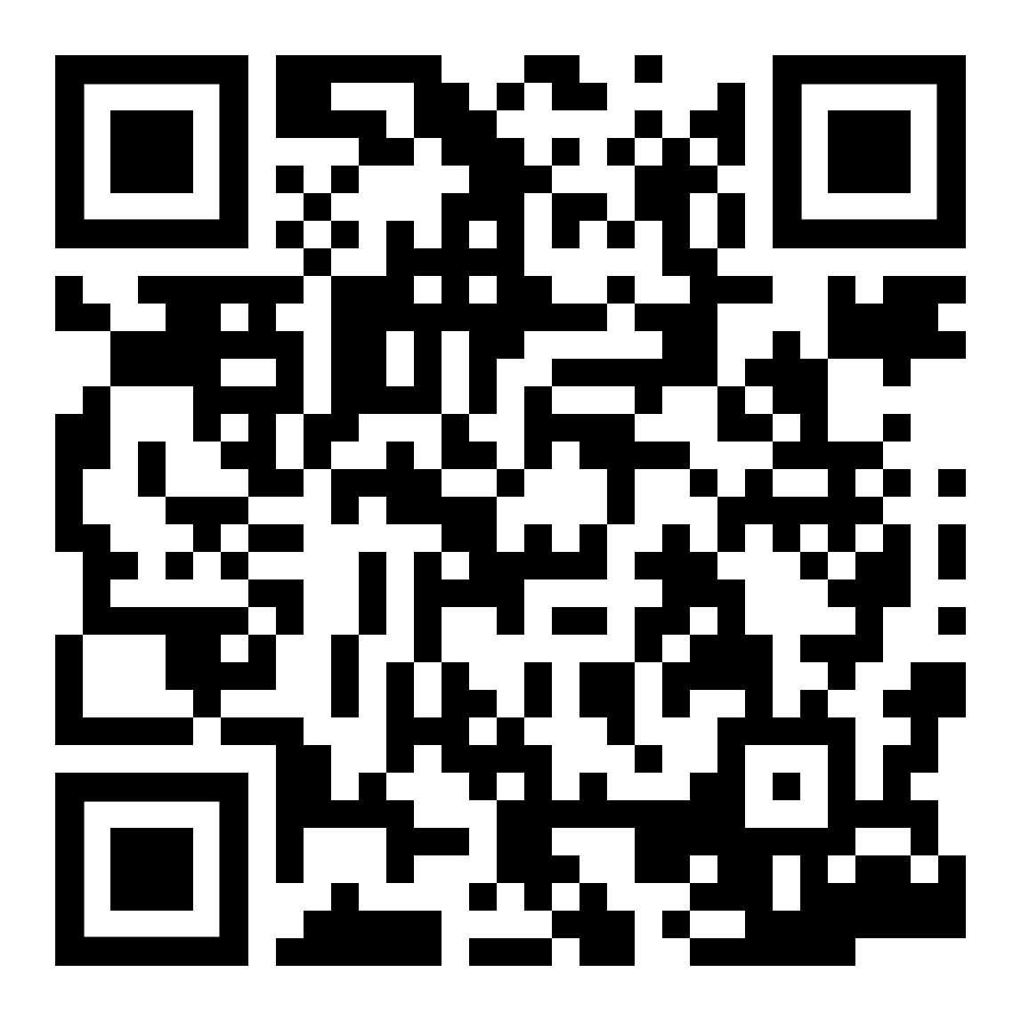
Welcome to Mission Popable!
Theme this year is “Mission Popable” – a play on detectives!
Best Advice: Be Excited! The families will feed off your attitude towards popcorn – positive or negative.
Second Best Advice: It’s just popcorn and it’s just Scouting! We can find a solution/answer/fix to anything.
Important Information –
Commission will be 50% for traditional and 40% for online
Please look at our resources on the MAC Popcorn Landing page or the MAC Popcorn Google Drive

Slide 6
Key Popcorn Dates
July 1 | Online Sales Begin
August 21 | Initial Order due at NOON
August 23 | Home Delivery Sign Up deadline (metro only)
September 4-5 | Initial Order Distribution Dates (see slide for details)
September 6 | Sale Begins!
Sept/Oct | Replenishment Orders (see slide for details)
September 29 | All Amnesty Day Returns due in System
October 29 | Final Order due by 11:59PM
Full list of popcorn dates can be found on the MAC Popcorn Landing Page

Slide 7
Why Popcorn?
Fund your unit’s adventures
Plan your Calendar & Budget with Popcorn sale in mind
Provides the opportunity for the Unit to provide an outstanding program at low out-of-pocket expense.
Scouts Learn
The value of hard work
How to earn their own way
Public speaking
Salesmanship & people sills
Setting and achieving goals
Notes:
Benefits for Scouts
Personal growth program that can be applied to advancement opportunities and service projects.
Earn Amazon eGift Cards
Millions of prize choices
Scouts choose the prizes they want
Units should also be planning/budgeting what does your Scouts and families get out of participating. Do you have a prize program with those instant rewards?
Are the Scout saving for a big trip. National Jambo is coming in 2026, Troops should take in consideration how their Scouts will fund this – do they know how much they will have to sell this year and next to afford it.

Slide 8
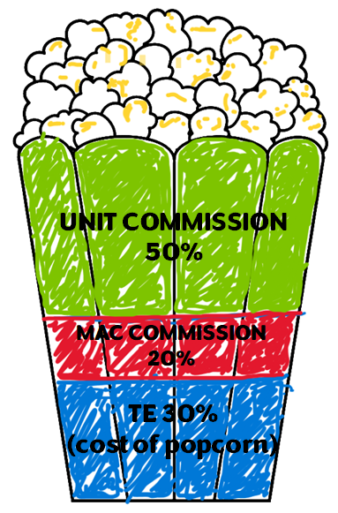
Commission Breakdown
MAC gives 50% of commission - Where does this go?
For every $100 sold:
$50 – back to unit
How each Unit using funds, is different
$30 – to Trail’s End
$20 – to Council
This includes:
District Prizes
Council Prizes
Popcorn Ball
TE Rewards
National Licensing Fee
Credit Cards & Freight

Slide 9
How the Sale Works & Technology

Slide 10
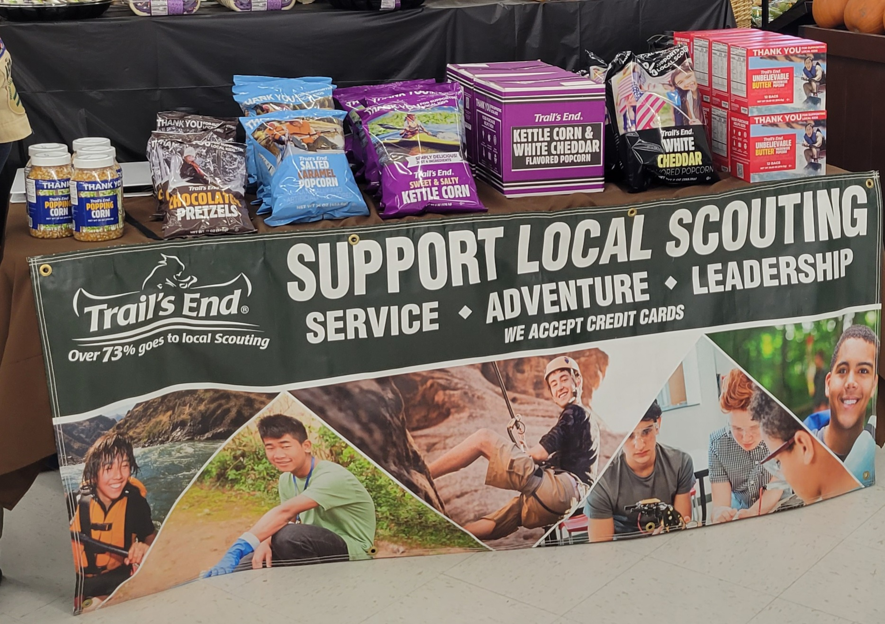
Ways to Sell
Storefront Sales
Reserve storefronts (either via Trail’s End or at the unit level) and then set up booths of product to sell to foot traffic customers of that location
Wagon Sales
Go door to door in your neighborhood, or out to friends and family. They can either buy product on the spot or place an order for delivery later.
Online Direct
Each Scout has a link that they can give out for their online store. Anything ordered via this link will be shipped directly to the customer. Online assortment may differ from on hand inventory. Free shipping with orders $65+.
Notes:
Currently (7/25) shipping is $11.99 for orders under $65 and $3 for Microwave.

Slide 11
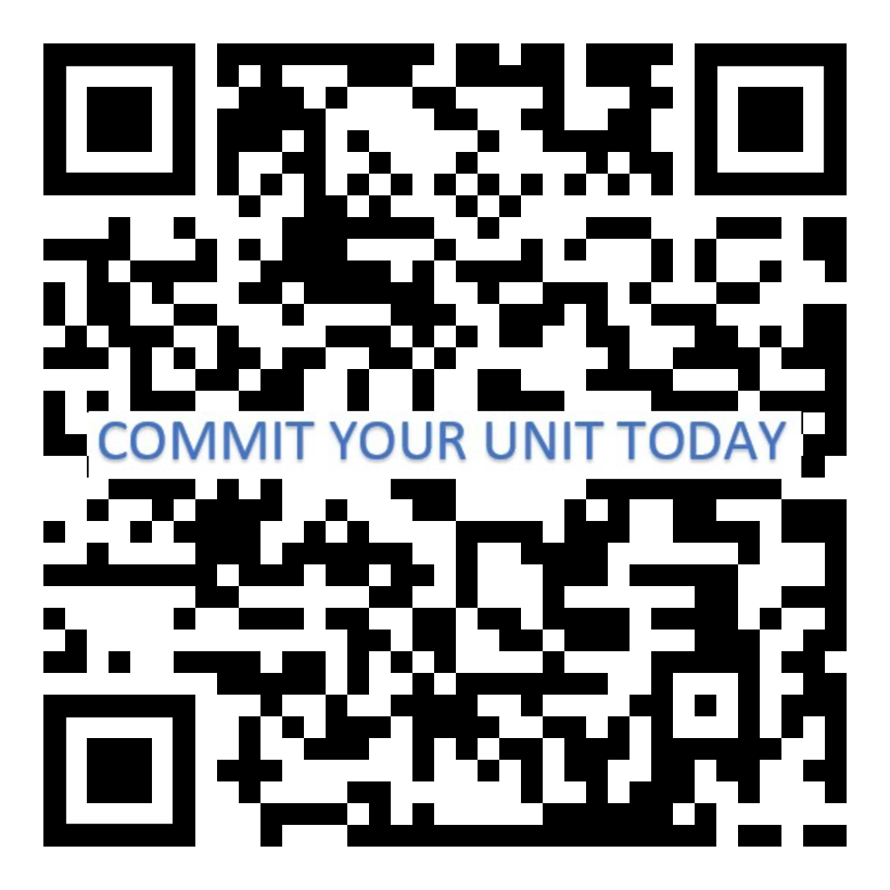
Use the Technology!
Trail’s End App for Scouts
Text APP to 62771 to download/register your Scout
NEW: Unit ID code
Record sales and accept credit cards
Sign up for storefront shifts
Track your goal
Record when you’ve delivered product
Share your online sales link
Claim rewards!
Unit Leader Portal
Online web page – NOT AN APP
https://portal.trails-end.com/
Manage your unit’s sale – inventory, storefronts, scouts, etc
Mobile-friendly via your phone’s browser
When your Scouts use their app, leaders can:
Track progress towards goals
Monitor inventory
Manage storefront shifts
Manage accounting
And more!
Reminder: ALL credit card fees paid for by TE/Council when sales are recorded via the app
Notes:
If you have not committed your unit or do not have a leader account yet, scan the qr code now as we talk through these

Slide 12
Use the Technology!
Trail’s End App for Scouts
NEW Scouts, will enter the Unit Code at registration.
Easier for Scouts to register.
Returning Scouts should use their previous account.
Be sure to remind them to check their Unit.
Multiple Scout Families:
One Scout per account.
Toggling makes switching between Scouts easy.
Scouts should each get rewarded for their individual hard work.
Multiple parents/guardians logging in:
Use same username & password
Add multi. MFA contacts.
Cell phone recommended
Tip: If they say they have registered, but not showing in your roster, have them look at their unit info.
Notes:
If they do not have their login info they can use the “forgot” features.
If you are a pack and you have Scouts that crossed over to a troop please move them to their new troop, if you have not done so yet.
They can also move their own accounts from the settings tab of the app.
If they have an old account that hasn’t been logged into, for 12 months, it should reactivate once they log in and should show up in your roster again. Or you can submit a ticket to Trail’s End.
I highly recommend talking to your families that typically put multiple Scouts under 1 account. Rewards/incentives are on a per account basis.
For example, there is only ONE t-shirt for that account that hits the goal level, or one patch. Accounts with multiple names on them will be excluded from things like the Top 50 spin party, etc.
Some of the updated tech features we will talk about will become available throughout the next couple of weeks.

Slide 13
Credit Cards
Many consumers prefer credit or debit card transactions
All Credit Cards transaction fees are covered when recorded via the Trail’s End app
Earn 1.25 reward points for every $1 sold in the app via credit card
No cash handling for Scouts/Unit
Communicates directly to the Unit.
Payout available after invoice is $0.
Square readers are compatible with the TE app
Do NOT use the Square app acct.
Square Bluetooth readers also accept Apple Pay and Google Pay
ALL Scouts can enter credit cards manually
OR send cart to customers device.
Be sure the payment is verified before letting the customer leave with product.
Parents pay Wagon Sales or Storefront cash due by clicking “Cash to Credit”/“Pay Now” (optional), converting to credit points.
Video
More intuitive Checkout
Notes:
Consumers carry less cash and are typically willing to spend more when using credit
Scouts earn more points wit credit.
Safer for the Scouts and Unit when there isn’t a bunch of cash.
Plus less frequent bank visits for the treasurer.
Most Units have a payout to the unit at the end of the season, than needing to hand in a check and/or tracking down money from scouts.
Square Brand readers are the only compatible reader, but they are not required.
They app now accepts Google Pay, Apple Pay, or Cash App Pay, in addition to credit and debit.
Digital wallets can tap the Bluetooth Reader OR send the customer the cart to compete the transaction by phone number OR they can scan the QR code.
Watch this video. https://www.youtube.com/watch?v=I_0TWpEGyQE&t=8s

Slide 14
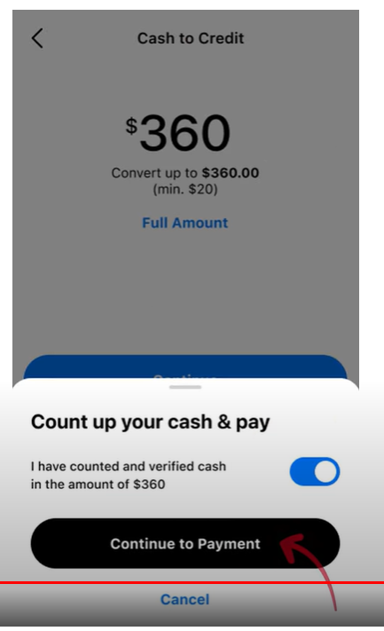
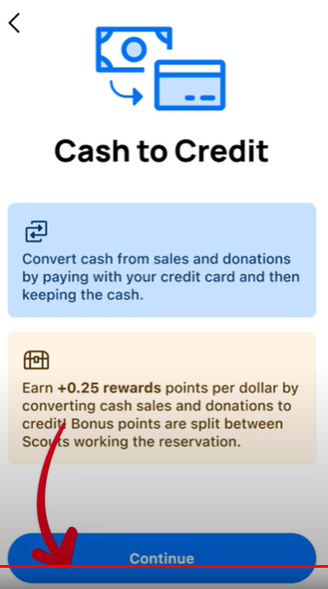
They can turn their cash sales into Credit….
Step 1:
If cash is owed from Wagons, click the Wagon tab.
For Storefronts: They need to be in the storefront tab and turn in cash by shift EOD
Step 2: Count cash & ensure all sales, including HH Donations have been recorded.
Step 3: Click continue
Step 4: verify cash and system matches before clicking “continue to payment”
Step 5: Complete transaction
How to video
Cash to Credit feature ETA 8/9/24.

Slide 15
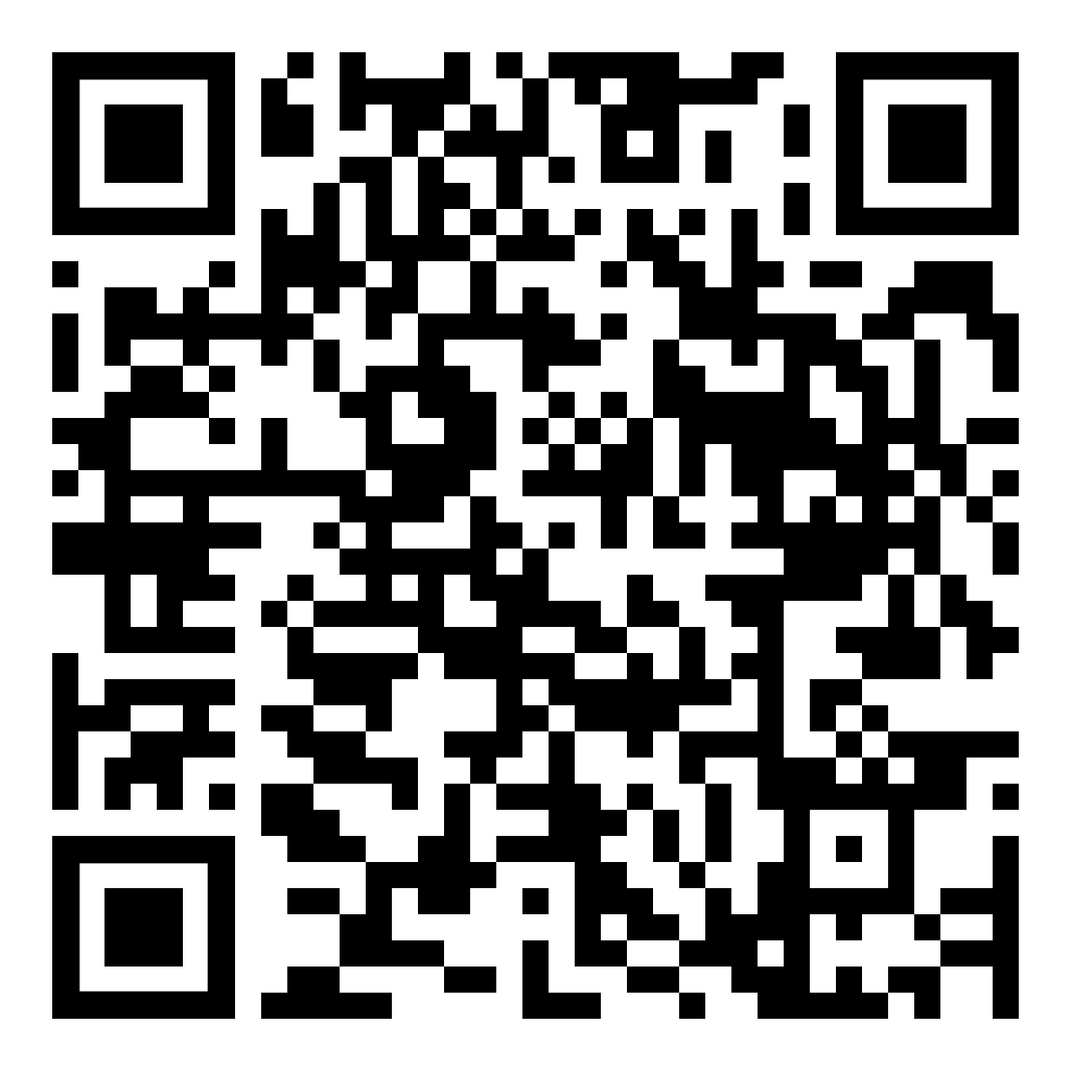
Storefronts
Set your defaults
“Calculation methods” with change for the entire season, including past sales
“Setup Defaults” will only change for new sites.
Use your search for store names, districts, etc.
Creating a New Site - Address selection powered by google
If you get a flag/error, please do not try to get around it.
Put your stores in AS SOON as they are scheduled.
2 hour shifts recommended.
What happens if the store is double booked?
Do not involve store management
If the store has two doors, can each unit take one?
Council will help settle this by looking at what is booked in the app – double check this on site as well.
End of Sale Tip: Thank your storefronts! Have the Scouts write a card and drop off with some extra popcorn at the end of the sale.
Notes:
Calculation methods will change instantly with any change. For correct display you may have to refresh or log out/in.
If you make any changes during the season, please communicate with your families of the change. During season calculation change is highly discouraged.
The Recommended calculation methods are the top 2 options. Please see the storefront PP for full details.
One Scout per shift: Scout credited for each sale recorded
Sales will be split between all scouts that work the shift.
We’ll go over some recommended items to have at storefronts towards the end with the check list.

Slide 16
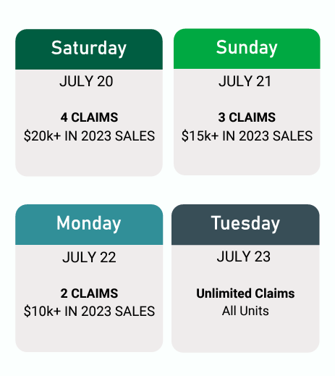
Trail’s End Managed Storefronts
See “Storefront Training” for more information on Popcorn Landing Page
KEEP CHECKING BACK THROUGHOUT THE SALE
Do not hold onto shifts you cannot fill, release back to other units.
Please do NOT contact the Reservation Stores.
Please see system for store instructions or reach out to our team and/or TE support for questions.
*Note: Walmarts can approve/deny our requests up to a week before requested reservation date.
Notes:
We will update the store list on the MAC landing page as soon as available so Units can call additional stores if they need.
We do not have a finalized release schedule for next year, but we are looking into what future possibilities will be. We hope to have this information sometime during this year’s campaign. With that said, we are looking at additional options that will encompass a wider range of units.
Booking in the current towns are based off of last year’s reservation list as well as foot traffic. We did we expand some of the resevations, especially to NP. Currently we’re trying to hit as may Units as possible within a reasonable travel radius. It’s not perfect, and we will reach out with surveys and questions to help improve support as we go forward.
Encourage Scouts to sign up as soon as they can. Your open date is up to you. Troops are sometimes better off opening now, so Scouts can get it on their busy schedules and plan accordingly and have less incoming new scouts. Where packs are better off to have them open at their kickoff, because of recruitment in the fall.

Slide 17
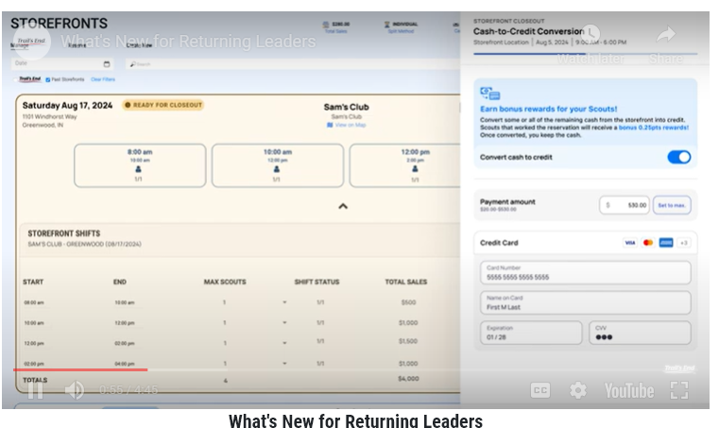
Storefronts
Cash to Credit available in the Leader Portal: Optional New Feature
Keep your eyes out for this new update.
New “Closeout Guide”
Minimize getting together with the Treasurer
Boost Scout points
Leaders have 48 hours after the shift.
More details to come
Cash to Credit options will update on August 8th in the system.
Notes:
I’m unsure what the launch date is on this feature.
Calculation methods will change instantly with any change. For correct display you may have to refresh or log out/in.
If you make any changes during the season, please communicate with your families of the change. During season calculation change is highly discouraged.
The Recommended calculation methods are the top 2 options. Please see the storefront PP for full details.
One Scout per shift: Scout credited for each sale recorded
Sales will be split between all scouts that work the shift.
The system enhancement is new this year and we know many that were not fully using the system, lowering that shift and store sales averages.
It makes it hard for us to justify more hours and stores, if the data doesn’t show we need them. This includes and Units making sure we use the slots we have available.

Slide 18
Storefronts
Ensure all Scouts are recording sales in their storefront shifts at the time of their storefront!
This is extremely important as it helps us determine how many store hours are needed for the next year and if they are stores we should keep available as reservations, etc.
Enhanced system features with top performing shifts highlighted.
Scouts can also see this in their app.
We check popcorn out to the Scout, they just use the Storefront schedule to sign up. What do we do?
Record the sales in the storefront. It will turn the storefront inventory negative. You can then move inventory from their wagon to the storefront and even it out.
What if a Scout from another Unit fills an open shift in our unit. We can’t split off the shift to another Unit. What do you recommend?
This can get messy and not recommended. Units have separate inventory and funds.
Instead, see if you can move Scouts around to another slot to fill it up and release the now empty slot so another Unit can pick it up.
Notes:
Calculation methods will change instantly with any change. For correct display you may have to refresh or log out/in.
If you make any changes during the season, please communicate with your families of the change. During season calculation change is highly discouraged.
The Recommended calculation methods are the top 2 options. Please see the storefront PP for full details.
One Scout per shift: Scout credited for each sale recorded
Sales will be split between all scouts that work the shift.
Based off the Unit to sot ratios and current select slots, we’re less worried about completely filling slots in your unit.
With that said, we would rather see a slot worked for 2 hours instead of sitting completely empty and unworked.
The system enhancement is new this year and we know many that were not fully using the system, lowering that shift and store sales averages.
It makes it hard for us to justify more hours and stores, if the data doesn’t show we need them. This includes and Units making sure we use the slots we have available.

Slide 19
Ordering Popcorn

Slide 20
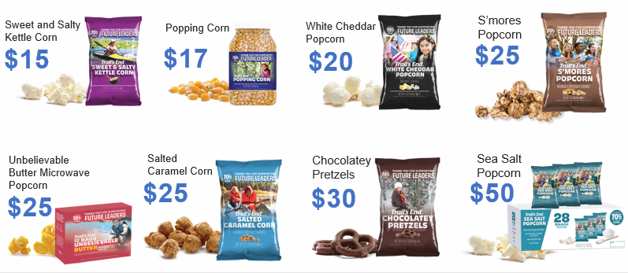
Products
NEW
Heroes & Helpers Donations
Donations in App will be automatically processed nightly & reflected on Unit orders, eliminating manual ordering, and saving time!
Online Products and Prices may vary from Council orders
Notes:
These are available products and prices for Storefronts and wagon sales. Online products and prices may vary.

Slide 21
Products
Chocolately Pretzels will be available approximately our second or third replenishment order. We will announce the date as soon as we know.
Online and on hand inventory may differ in availability and pricing
I received a damaged bag/case, what do I do? Take a picture of the damage and email it to MAC@scouting.org. Please include your unit number and district. The damaged product will be removed from your order.

Slide 22
Ordering Popcorn
Initial Order (aka pre-order or take order)
This order is for units who want popcorn in their hands when the sale begins on September 6th. This product will be received September 4th or 5th
If you are planning to do any storefronts, you NEED to place an initial order.
Full cases.
Units can pre-order up to 100% of their total 2023 sale.
If your unit did not sell in 2023, please send your proposed order to popcorn@macscouts.org and it will be reviewed.
Orders must be submitted online by August 21st at Noon.
If your unit is not committed to the sale, your order will not be placed.
Final Order
This is the end of sale order. You will order the same way as Initial Order.
Review all “Undelivered” Wagon orders – report available in the “reports” tab
Orders must be submitted online by October 29th at 11:59PM
For this order, you can order by case or container
Heroes and Helpers no longer needed to be entered in this order.

Slide 23
Ordering Popcorn
To Submit an Order:
Log in to Trail’s End leader portal
Click “Order Popcorn” button
Click “Choose Delivery…” button and select the order you are placing
These options would include “Initial Order”, “Replenishment Order “x””, or “Final Order.”
Enter the dollar amount of product you want to order and TE will auto populate an order based on regional averages. You can edit as needed and this will only auto fill on your initial order.
Orders over $3000.
Click SUBMIT when you are finished with your order.
You will receive an order confirmation to your email address once your order is approved by council. Council will not approve any orders before the order deadline.
This is how you will order for any order – initial, replenishments, or final.

Slide 24
Warehouse Information
District | Warehouse | Address | City
NEN - Columbus | AG Park | 822 15th St. | Columbus, NE
NEN - Norfolk | Lutheran High Northeast | 2010 N. 37th St. | Norfolk, NE
TB East | United Presbyterian Church | 1500 Industrial Ave | Bedford, IA
WE | Echo Electric | 1200 Cunningham Dr. | Sioux City, IA
NWI – Spencer | Spencer AG Center | 1901 E. 8th St | Spencer, IA
NWI – Ft. Dodge | White Transfer & Storage | 1834 US 20 Business | Ft. Dodge, IA
BH/IH/WW/TB West | Metro Warehouse (Ford Storage) | 10364 South 136th St | Omaha, NE
GR | Jayhawk Box | 1150 S. Union St. | Fremont, NE
OH | James Sheehan Warehouse | 911 7th St. | Harlan, IA
Buffalo Bill | Quality Brands 3rd | 720 N. Lake Drive | North Platte, NE
Covered Wagon | Mead Lumber 2nd | 1440 W. 56th Street | Kearney, NE
Five Rivers | Goodwill Industries 1st | 1440 S. Lincoln | Grand Island, NE

Slide 25
Warehouse Information
Initial Order Pick Up Schedule:
September 4th – BH, IH, WW, TB West, NEN
September 5th – BH, IH, WW, TB West, TB East, WE, NWI, OH, GR, BB, CW, FR
Exact timing and sign ups will be communicated to units by your district team after initial orders are placed.
Final Order Pick Up:
TB East, WE, NWI, OH, GR, BB, FR, CW: November Round Table.
BH, IH, WW, TB West: Council Office
Please keep an eye out for additional/finalized information

Slide 26
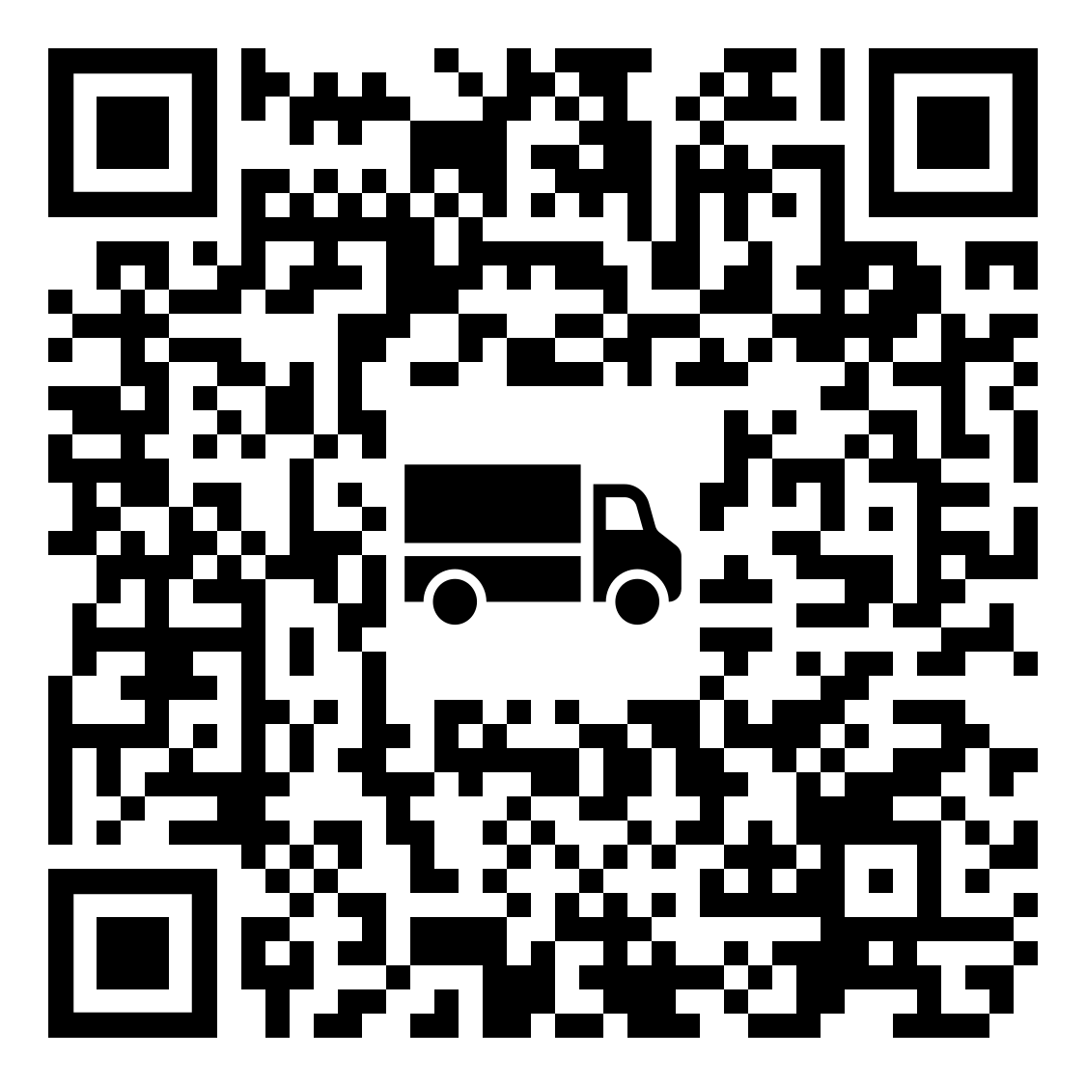
Home Delivery
BH, IH, WW Only
Home Delivery is where council will deliver your popcorn directly to your house September 4th or 5th
Limited to first 40 units in the Metro Only
Fee based on amount of product ordered
Sign up here: https://www.scoutingevent.com/326-HomeDelivery24
You must register by August 23rd at 11:59PM.

Slide 27
Replenishment Orders
Throughout the sale, MAC will have opportunities to order additional popcorn. These happen weekly in the metro and once in our rural districts. Anyone can drive to Omaha to pick up a replenishment at anytime during the sale if they’ve placed the order on time.
Replenishment orders will be picked up on Thursdays between 2PM and 6PM.
Orders must be placed in the system by 7PM the Sunday before.
Any orders not picked up by 6PM will be canceled.
Rural Replenishment – We will have a replenishment brought out to the rural district roundtables the week of 10/1 and 10/3. These orders will need to be in the system by 9/29 at 7PM to receive your product.
Order Due | 9/8/24 | 9/15/24 | 9/22/24 | 9/29/24 | 10/6/24
Pick Up | 9/12/24 | 9/19/24 | 9/26/24 | 10/3/24 | 10/10/24

Slide 28
Returning Popcorn

Slide 29
Amnesty Day
Amnesty day is an opportunity for units who have either over ordered, or their sale isn’t going as planned, to return product without it counting towards their 10%. These returns must be submitted into the system by September 29th 7PM and brought back to council on time to be considered accepted. No chocolate accepted.
September 30 | Metro Amnesty Day
October 1 | Tuesday RT Rural Amnesty Day
October 3 | Thursday RT Rural Amnesty Day
*All amnesty returns must be in the system by September 29th at 7PM
Both Amnesty Day and Final Returns are by case only
Notes:
Amnesty Day is a great way to bring product that you may have over ordered. For example, if you over ordered kettle by a few cases. Or maybe you didn’t have as many scouts return in the fall or you didn’t hit your recruitment goal. Whatever the case may be.
With that said, Popcorn MUST be in completed cases, with same product. In the correct flavor case and undamaged. Please do not show up with the 5 bags of kettle, 5 white cheddar, and 2 salted caramel – it will go back home with you.
I recommend hanging on to some boxes throughout the season, so you have some for Amnesty or final return days. The amount of boxes have and can hang on to, is limited.
Remember Amnesty day is not final sales day – keep selling, you have a whole month to support Scouts reaching their sales goal.
Please do not abuse the amnesty day privilege. Each year since we’ve started this, we’re seeing more Units place large replenishment orders with large amnesty returns, little to no sales in October.

Slide 30
Final Returns
MAC allows returns up to 10% of your total pre-ordered popcorn. This includes your initial order and any replenishment orders. All returns must be in the system by October 29th at 11:59PM and returned on time to be accepted. No chocolate accepted
October 29-30 | Metro Returns (a sign up will be sent out)
November 5 | Tuesday RT Rural Returns
November 7 | Thursday RT Rural Returns
To enter a return in the system – click “Popcorn Orders and Returns” tab.
Under the popcorn orders page, click “view” next to your approved unit order with the inventory to be returned.
Choose which return you are placing (amnesty or final)
Click the “Return Inventory to Council” button
Enter the number of cases to be returned for each product
Click the “Submit Return Request” to complete the form
Once the council has accepted the product return, adjustments will be made to your popcorn invoice statement to reflect the returned products.
System Returns, will not be accepted until AFTER physical product return.
Notes:
If something changes in step by step, we will update “how to” during a What’s Poppin Newsletter and post it to social Media.

Slide 31
Rewards
Notes:
Scouts receive rewards and recognitions beyond what the Unit provides and funding their Scouting adventures. We’ll dive into what TE and Council rewards.

Slide 32
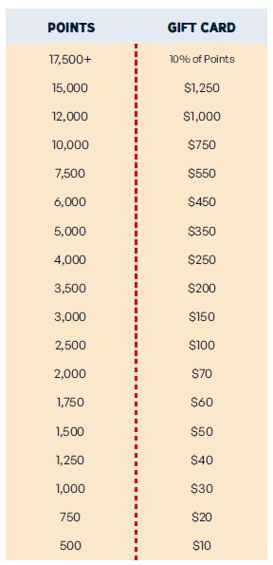
Trail’s End
Record all sales via the app to qualify
Scouts earn points
1.25 points for every $1 sold app credit card and online
1 point for every $1 sold app cash
Unit Leaders submit Rewards at the end of the season and Scouts claim them in their app.
Receive an Amazon e-gift card and then choose your prizes from Amazon!
Did You Know?! 1,750 points (approximately $1,500 in sales) helps fund most Scouts’ Year of Scouting which includes registration fees, handbook, uniform, Unit dues, camp, Scout Life magazine and much more. Plus, Scouts earn a $60 Amazon.com e-gift card!*
2024 Bonus Rewards*
• Sell $500/hour per Scout for any 2 hour storefront shift or
longer (July 1 - December 15) and earn 0.5 bonus points
per $1 sold
• Sell $250+ online (July 1 – August 31) and earn 100 bonus points
*All sales must be recorded in the app to qualify for any Trail's End rewards
Notes:
TE Bonus Rewards (2024)
To qualify, sales must be recorded in the Trail’s End App and
your Unit must select the calculation method -
One Scout per shift: Scout credited for each sale recorded (Top option on the calculation list).

Slide 33
Council
Scout Mission – Patch set!
$250 in Heroes & Helpers Donations
$250 in Online sales
$250 at Storefronts
$1000+ in Total Sales (any combination of wagon, storefront, & online sales)
*Receive 1 patch with each completed mission. Scouts can earn up to all 4!
Sales must be entered into the system by 10/29/24 11:59 PM (CT)
No need to send in completions, all rewards are pulled directly from the system.
Keep an eye out for Pop-up Missions and details through out the season for additional rewards!
Top 10 Units in EACH District will receive 2024 plaques.
Top Selling Unit in EACH District will receive a Popcorn Party.
To qualify for any of the rewards provided by council, sales must be recorded in the app. All prizes not picked up/received by January 31st, 2024 are forfeited.
Notes:
Some patches may be combined. For example, if the Scout has $250 HH Donations on line, they complete both missions, but it does not count for $500 in sales.
Pop-up missions maybe be Unit or Scout rewards. Keep an eye out for communications in WPN and social Media.

Slide 34
Council
Each year the council offers additional rewards for our scouts! See below for this year’s details. All prizes are based on sales recorded in the app by 10/29 at 11:59PM.
 | Patch | Popcorn Ball | Council Strip | T-Shirt | Spin Party | Trophy
All Sellers | X
$1500 Club | X | X
$2024 Club | X | X | X
$3000 Club | X | X | X | X
Top 50 | X | X | X | X | X
Top 10 | X | X | X | X | X | X
To qualify for any of the rewards provided by council, sales must be recorded in the app. All prizes not picked up/received by January 31st, 2025 are forfeited.
Notes:
As we talked about before, these rewards are in addition to what you Unit choses to do as well as TE Rewards.
Again, this is where you can get a better idea of what we were talking about with each Scout having their own account.

Slide 35
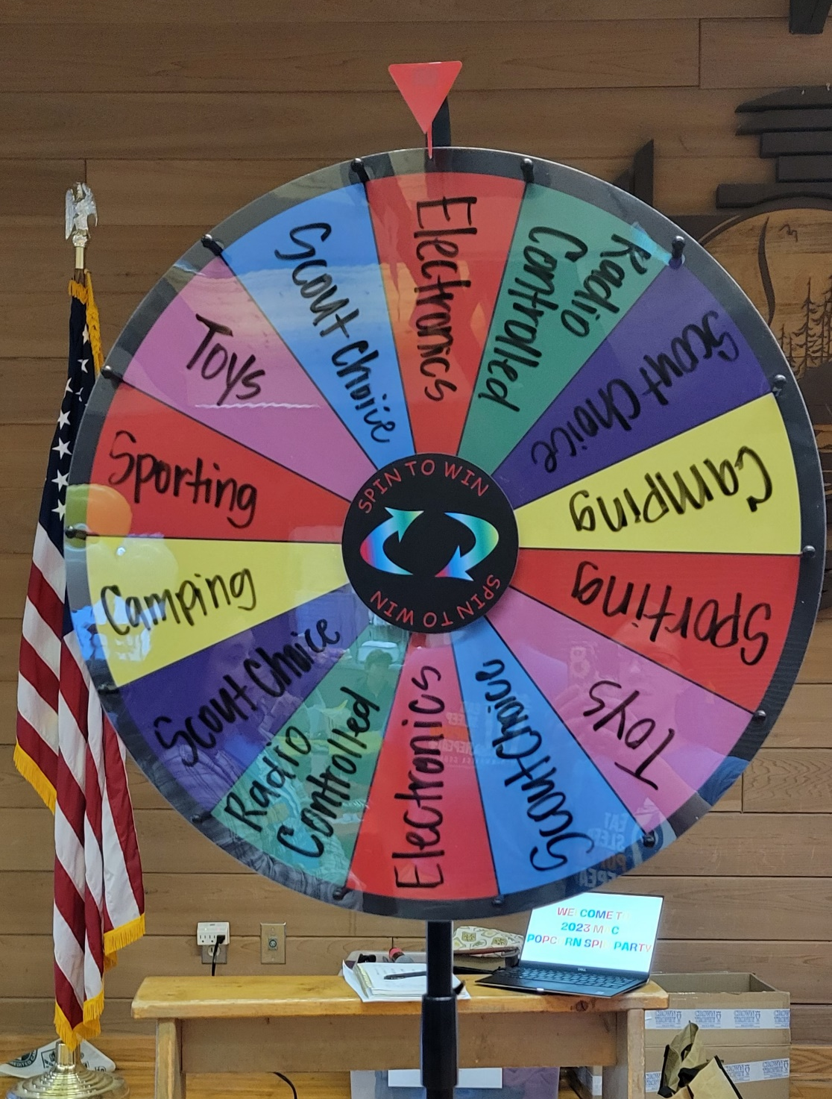
Council
Popcorn Ball:
Scout who sells over $1,500
4 FREE tickets
UNO Men’s Hockey Game
12/29 at 3PM
Extra tickets available for purchase, $10 each.
Must register to attend.
Spin Party:
Top 50 sellers, who sell over $3K.
A spin is earned for every $3K sold per Scout.
Date TBD
Each spin earns a prize like electronics, a nerf gun, gift cards, etc.
To qualify for any of the rewards provided by council, sales must be recorded in the app. All prizes not picked up/received by January 31st, 2024 are forfeited.
Notes:
There will be an optional “Can Not attend” for the Popcorn Ball. We’ll have more details to come on exactly how much the gift card will be.
The Gift card will be MAC Bucks. MAC Bucks can be used at any of our Council Scout Shops, any registrations or camp trading posts.

Slide 36
Tips & Tricks

Slide 37
Tips & Tricks
If you are having issues placing an order, confirm you are on the correct year and selected the delivery location.
If you receive a damaged case or damaged bag, please take pictures and email to mac@scouting.org. You will have the damaged items removed from your invoice.
Following our social media is a great way to stay up to date on information
BOTH your District and the Council pages
Please make sure you have MAC@Scouting.org and Popcorn@MacScouts.org as approved emails.
Make sure you have your district kernels email approved as well
Again, it’s just popcorn and it’s just Scouting. Everything is fixable!
Open communication is key – unit level, district level, council level
We can’t fix what we don’t know about
The TE “Training Tab” has a ton of great resources, especially for “logistical/system” questions

Slide 38
Taking this Back to Your Unit

Slide 39
Steps for a Successful Sale
Step 1: Unit Leader Preparation
Attend Council Training (woohoo! You’re already crushing this!)
Attend a TE Webinar and their Training Tab
Plan your program year and budget. Use this to then set your Popcorn goal.
Reserve your storefronts or storefront claims
Obtain supplies needed:
Square readers
Storefront supplies (tablecloth, product, cash bag, etc)
Unit incentives/fun!
Plan and prepare for your Unit Kick Off! –
Step 2: Prepare your Scouts & Families
Encourage all Scouts to download the TE App
EACH scout should have their OWN registration
Encourage Scouts to review the training tab
Motivate with incentives and how funds will be used
Communicate key dates and stay excited throughout the sale
Educate your families, new and returning, about what the popcorn sale is, how it works, what to expect, etc.
Notes:
Kick off – check out the training tab for ideas. Prepare what Scouts will receive/what your unit plan is. This is the place to include any information about earning money towards trips – National Jambo 2026, summer camp, membership dues, etc. Plan these out/talk with the committee – be prepared to have all of this info at kickoff.
- Some units do “sales academies” at their kickoff – get top sellers and returning sellers to help with your stations.
Scouts have a lot of great videos to help with sales tips, pitch, and overcoming excuses, etc.
Be excited!

Slide 40
Steps for a Successful Sale
Step 3: Hold Unit Kick Off
Make it fun! Get excited and use the theme (Mission Popable!)
Set stretch goals – as a unit AND per Scout!
Have a help station for any questions about the sale or the app
Talk about prizes – unit prizes, district prizes, council prizes and TE prizes!
Role play and let the Scouts practice going door to door, asking for a sale at a storefront, etc.
Educate the parents!
Have Scouts create and perfect their sales pitch!
Step 4: SELL!
Go out and sell!
Check back for Storefront Shifts other units are unable to fill throughout the sale
Encourage prizes throughout the sale.
Keep your families motivated – provide weekly updates and shout outs!

Slide 41
Unit Kick Off Ideas
Make it fun and get excited!!
Use the theme
Keep it simple – make sure the families get the important information
Agenda –
Gathering/Opening
Why Popcorn
Funding your unit? Dues? An event? All of the the above?!
What skills do they learn?
What’s the plan
Provide important dates
Explain the sale – especially how we sell and what they are responsible for!
What’s the Goal?
Communicate, communicate, communicate.
Unit and Scout goals!
Other sale details
Fun things that will happen along the way
Technology
Make sure they are on the app and understand how to use it!
Q & A
Stick around and answer any questions for new/returning parents

Slide 42
How to Help Other Units
Unit to Unit Transfers
Go to the Popcorn Orders tab
Click “view” next to the order with the inventory to be transferred
Click the “Transfer Inventory” button and select the District and Unit from the dropdowns that is receiving the inventory
Enter the quantities (Cases/Containers) to be transferred
Click the “Submit Transfer Request” to complete the form
How to Receive Popcorn from Another Unit
After the transferring unit submits the transfer request, you’ll be notified via email.
On your TE account, go to the “Transfers & Returns” tab
Review the pending product transfers. If correct, click the “approve” button and the “reject” button if incorrect (then communicate with the Unit to get it corrected)
Once the receiving unit has accepted the transfers, each unit’s invoice will be updated.
Mid-America Council Popcorn
(group)
OTC Popcorn
(page)
Notes:
I will create a post in the OTC popcorn Page, so Units can post/comment when they are looking for product and have available product to transfer. Please put approx. town/area and take details to DM. Please remember it is a public page and to use caution when commenting.

Slide 43
Kernel Checklist
July
Attend Popcorn training
Plan your unit kick off
Claim your storefronts!
August
Place your initial order by August 21st
Hold your unit kick off! Make sure parents have the information they need.
September
Hold your unit kick off if you didn’t in August.
Pick up your popcorn
Check in on your families to make sure their sale is going well
Place any needed replenishment orders
October
Place any needed replenishment orders
Participate in Amnesty Day or Pop Swaps as needed
Continue to check in on your families
Wrap up your sale & make sure everything is final in the system by 10/29
Complete any final returns
November
Pick up any final order popcorn
Pay your invoice or input your information to receive your payout
Celebrate your awesome sale with your unit.

Slide 44
Contact List
District | District Kernel | Email | District Executive | Email
Black Hawk | Ernie Hemmer | blackhawkpopcorn@gmail.com | Ryan LaViolette | Ryan.LaViolette@scouting.org
Iron Horse | Lisa Hayford | ironhorsepopcorn@gmail.com | Dustin Smith | Dustin.Smith@scouting.org
Wagon Wheel | Amanda Lopez | wwdpopcorn@gmail.com | Bryan Balvanz | Bryan.Balvanz@scouting.org
Goldenrod | Chad Adams | goldenrodpopcorn@gmail.com | Cynthia Lieb | Cynthia.Lieb@scouting.org
NE Nebraska | Kayla Steiner | diamonddickpopcorn@gmail.com | Vacant
Ohwahnasee | Melissa Thygesen | ohpopcorn@macscouts.org | Becky Mahoney | Becky.Mahoney@scouting.org
Trailblazer | Jen Wilkinson | tbpopcorn@macscouts.org | Vacant
NW Iowa | Jobina Kirby | kirbygj@yahoo.com | Daryl Milius | Daryl.Milius@scouting.org
War Eagle | Bill Splitter | williamsplitter@yahoo.com | Daryl Milius | Daryl.Milius@scouting.org
Buffalo Bill |  |  | Vacant
Covered Wagon |  |  | Josh Sikes | Joshua.Sikes@scouting.org
Five Rivers | Carmen | carmen@ss-cpas.com; j_stromer@msn.com | Kevin Boilesen | Kevin.Boilesen@scouitng.org
Council | Danessa Hemmer | Popcorn@macscouts.org | Tina Douglas | Tina.Douglas@scouting.org
MAC Popcorn Landing Page
MAC Popcorn Facebook
Notes:
District Kernel opportunities

Slide 45
Questions?

