Slide 1
Unit # 2024 Popcorn Sale

Slide 2
Kick Off Outline
Gathering/Opening
Why Popcorn
Important Dates
Goals
Unit & Scout
Technology/App
Products
How to Sell
Storefront
Wagon
Online
Incentives
Unit
District & Council
Other Unit Specific Sale Details (Contact person, hours to come by for popcorn, etc)
Q & A

Slide 3
Why Popcorn?
Fund your unit’s adventures
Plan your Calendar & Budget with Popcorn sale in mind
Provides the opportunity for the Unit to provide an outstanding program at low out-of-pocket expense.
Scouts Learn
The value of hard work
How to earn their own way
Public speaking
Salesmanship & people sills
Setting and achieving goals
Notes:
Benefits for Scouts
Personal growth program that can be applied to advancement opportunities and service projects.
Earn Amazon eGift Cards
Millions of prize choices
Scouts choose the prizes they want
Units should also be planning/budgeting what does your Scouts and families get out of participating. Do you have a prize program with those instant rewards?
Are the Scout saving for a big trip. National Jambo is coming in 2026, Troops should take in consideration how their Scouts will fund this – do they know how much they will have to sell this year and next to afford it.

Slide 4
Key Popcorn Dates
September 6 | Sale Begins!
October 29 | Final Order due by 11:59PM

Slide 5
Goals
Unit Goal
Scout Goals

Slide 6
Use the Technology!
Trail’s End App for Scouts
Text APP to 62771 to download/register your Scout
NEW: Unit ID code
Record sales and accept credit cards
Sign up for storefront shifts
Track your goal
Record when you’ve delivered product
Share your online sales link
Claim rewards!
OUR UNIT CODE:
Reminder: ALL credit card fees paid for by TE/Council when sales are recorded via the app
Notes:
If you have not committed your unit or do not have a leader account yet, scan the qr code now as we talk through these

Slide 7
Use the Technology!
Trail’s End App for Scouts
NEW Scouts, will enter the Unit Code at registration.
Easier for Scouts to register.
Returning Scouts should use their previous account.
Be sure to remind them to check their Unit.
Multiple Scout Families:
One Scout per account.
Toggling makes switching between Scouts easy.
Scouts should each get rewarded for their individual hard work.
Multiple parents/guardians logging in:
Use same username & password
Add multi. MFA contacts.
Cell phone recommended
Tip: If they say they have registered, but not showing in your roster, have them look at their unit info.
Notes:
If they do not have their login info they can use the “forgot” features.
If you are a pack and you have Scouts that crossed over to a troop please move them to their new troop, if you have not done so yet.
They can also move their own accounts from the settings tab of the app.
If they have an old account that hasn’t been logged into, for 12 months, it should reactivate once they log in and should show up in your roster again. Or you can submit a ticket to Trail’s End.
I highly recommend talking to your families that typically put multiple Scouts under 1 account. Rewards/incentives are on a per account basis.
For example, there is only ONE t-shirt for that account that hits the goal level, or one patch. Accounts with multiple names on them will be excluded from things like the Top 50 spin party, etc.
Some of the updated tech features we will talk about will become available throughout the next couple of weeks.

Slide 8
Credit Cards
Many consumers prefer credit or debit card transactions
All Credit Cards transaction fees are covered when recorded via the Trail’s End app
Earn 1.25 reward points for every $1 sold in the app via credit card
No cash handling for Scouts/Unit
Communicates directly to the Unit.
Payout available after invoice is $0.
Square readers are compatible with the TE app
Do NOT use the Square app acct.
Square Bluetooth readers also accept Apple Pay and Google Pay
ALL Scouts can enter credit cards manually
OR send cart to customers device.
Be sure the payment is verified before letting the customer leave with product.
Parents pay Wagon Sales or Storefront cash due by clicking “Cash to Credit”/“Pay Now” (optional), converting to credit points.
Video
More intuitive Checkout
Notes:
Consumers carry less cash and are typically willing to spend more when using credit
Scouts earn more points wit credit.
Safer for the Scouts and Unit when there isn’t a bunch of cash.
Plus less frequent bank visits for the treasurer.
Most Units have a payout to the unit at the end of the season, than needing to hand in a check and/or tracking down money from scouts.
Square Brand readers are the only compatible reader, but they are not required.
They app now accepts Google Pay, Apple Pay, or Cash App Pay, in addition to credit and debit.
Digital wallets can tap the Bluetooth Reader OR send the customer the cart to compete the transaction by phone number OR they can scan the QR code.
Watch this video. https://www.youtube.com/watch?v=I_0TWpEGyQE&t=8s

Slide 9
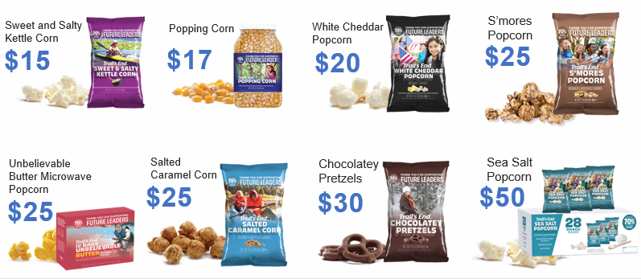
Products
NEW
Heroes & Helpers Donations
Donations in App will be automatically processed nightly & reflected on Unit orders, eliminating manual ordering, and saving time!
Online Products and Prices may vary from Council orders
Notes:
These are available products and prices for Storefronts and wagon sales. Online products and prices may vary.

Slide 10
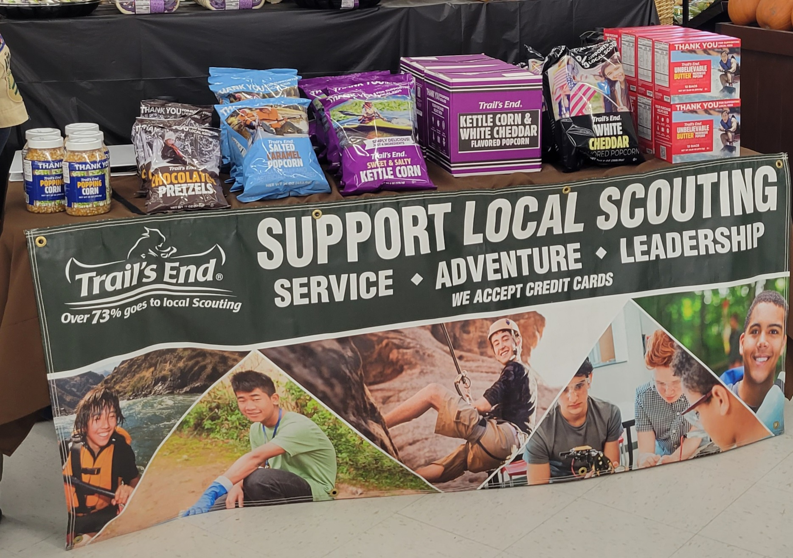
Ways to Sell
Storefront Sales
Reserve storefronts (either via Trail’s End or at the unit level) and then set up booths of product to sell to foot traffic customers of that location
Wagon Sales
Go door to door in your neighborhood, or out to friends and family. They can either buy product on the spot or place an order for delivery later.
Online Direct
Each Scout has a link that they can give out for their online store. Anything ordered via this link will be shipped directly to the customer. Online assortment may differ from on hand inventory. Free shipping with orders $65+.
Notes:
Currently (7/25) shipping is $11.99 for orders under $65 and $3 for Microwave.

Slide 11
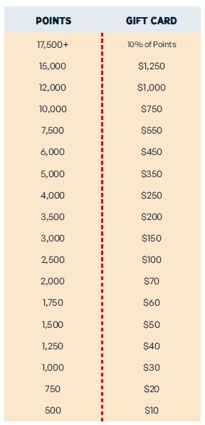
Trail’s End
Record all sales via the app to qualify
Scouts earn points
1.25 points for every $1 sold app credit card and online
1 point for every $1 sold app cash
Unit Leaders submit Rewards at the end of the season and Scouts claim them in their app.
Receive an Amazon e-gift card and then choose your prizes from Amazon!
Did You Know?! 1,750 points (approximately $1,500 in sales) helps fund most Scouts’ Year of Scouting which includes registration fees, handbook, uniform, Unit dues, camp, Scout Life magazine and much more. Plus, Scouts earn a $60 Amazon.com e-gift card!*
2024 Bonus Rewards*
• Sell $500/hour per Scout for any 2 hour storefront shift or
longer (July 1 - December 15) and earn 0.5 bonus points
per $1 sold
• Sell $250+ online (July 1 – August 31) and earn 100 bonus points
*All sales must be recorded in the app to qualify for any Trail's End rewards
Notes:
TE Bonus Rewards (2024)
To qualify, sales must be recorded in the Trail’s End App and
your Unit must select the calculation method -
One Scout per shift: Scout credited for each sale recorded (Top option on the calculation list).

Slide 12
Council
Scout Mission – Patch set!
$250 in Heroes & Helpers Donations
$250 in Online sales
$250 at Storefronts
$1000+ in Total Sales (any combination of wagon, storefront, & online sales)
*Receive 1 patch with each completed mission. Scouts can earn up to all 4!
Sales must be entered into the system by 10/29/24 11:59 PM (CT)
No need to send in completions, all rewards are pulled directly from the system.
Keep an eye out for Pop-up Missions and details through out the season for additional rewards!
To qualify for any of the rewards provided by council, sales must be recorded in the app. All prizes not picked up/received by January 31st, 2025 are forfeited.
Notes:
Some patches may be combined. For example, if the Scout has $250 HH Donations on line, they complete both missions, but it does not count for $500 in sales.
Pop-up missions maybe be Unit or Scout rewards. Keep an eye out for communications in WPN and social Media.

Slide 13
Council
Each year the council offers additional rewards for our scouts! See below for this year’s details. All prizes are based on sales recorded in the app by 10/29 at 11:59PM.
 | Patch | Popcorn Ball | Council Strip | T-Shirt | Spin Party | Trophy
All Sellers | X
$1500 Club | X | X
$2024 Club | X | X | X
$3000 Club | X | X | X | X
Top 50 | X | X | X | X | X
Top 10 | X | X | X | X | X | X
To qualify for any of the rewards provided by council, sales must be recorded in the app. All prizes not picked up/received by January 31st, 2025 are forfeited.
Notes:
As we talked about before, these rewards are in addition to what you Unit choses to do as well as TE Rewards.
Again, this is where you can get a better idea of what we were talking about with each Scout having their own account.

Slide 14
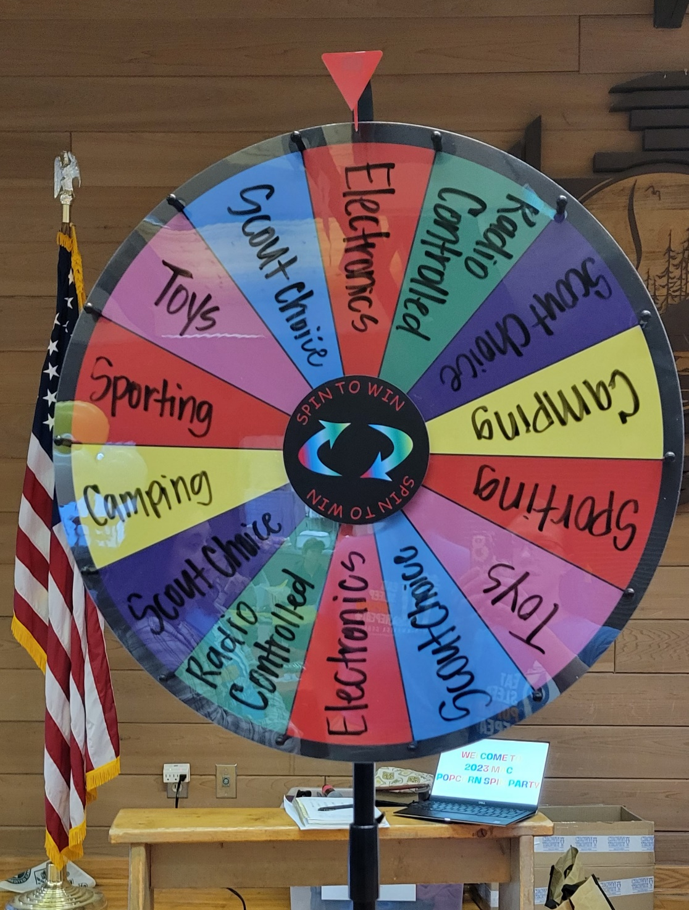
Council
Popcorn Ball:
Scout who sells over $1,500
4 FREE tickets
UNO Men’s Hockey Game
12/29 at 3PM
Extra tickets available for purchase, $10 each.
Must register to attend.
Spin Party:
Top 50 sellers, who sell over $3K.
A spin is earned for every $3K sold per Scout.
Date TBD
Each spin earns a prize like electronics, a nerf gun, gift cards, etc.
To qualify for any of the rewards provided by council, sales must be recorded in the app. All prizes not picked up/received by January 31st, 2025 are forfeited.
Notes:
There will be an optional “Can Not attend” for the Popcorn Ball. We’ll have more details to come on exactly how much the gift card will be.
The Gift card will be MAC Bucks. MAC Bucks can be used at any of our Council Scout Shops, any registrations or camp trading posts.

Slide 15
Unit
Notes:
There will be an optional “Can Not attend” for the Popcorn Ball. We’ll have more details to come on exactly how much the gift card will be.
The Gift card will be MAC Bucks. MAC Bucks can be used at any of our Council Scout Shops, any registrations or camp trading posts.

Slide 16
Unit Specific Information
Notes:
There will be an optional “Can Not attend” for the Popcorn Ball. We’ll have more details to come on exactly how much the gift card will be.
The Gift card will be MAC Bucks. MAC Bucks can be used at any of our Council Scout Shops, any registrations or camp trading posts.

Slide 17
Questions?

