Slide 1
2025 Unit Growth Seminar

Slide 2
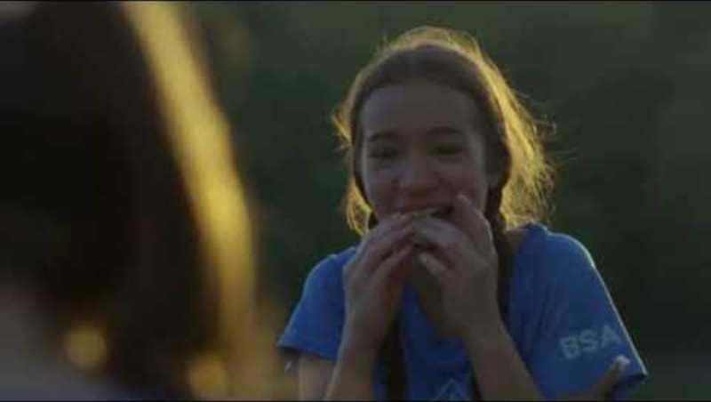

Slide 3
Objectives and Topics
Welcome
Membership Campaign overview
How to market your unit
Conducting Recruiting Events
Questions?

Slide 4
Membership Campaign
Goal
2025 Membership playbook
Timeline- Page 8
Resources and where to find them

Slide 5

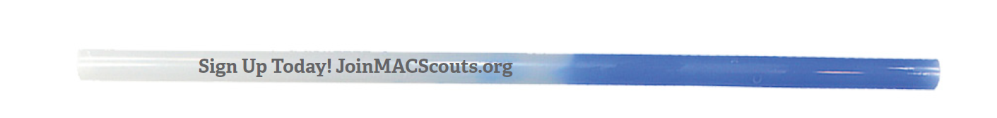
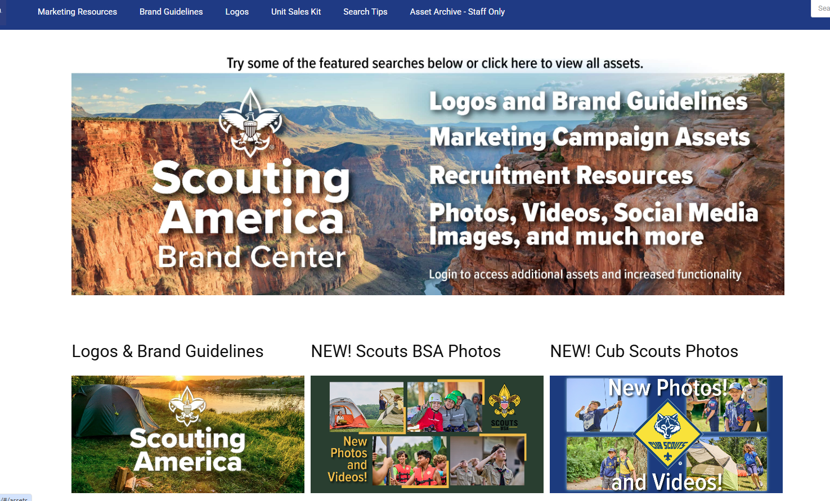

Assets available

Slide 6
How to market your unit

Slide 7
Beascout.org vs joinmacscout.org
A Unit’s pin is a listing detailed with contact information, meeting location, fees, etc.
Every unit has a location on a map and the marker looks a pin. Families can search by zip code and unit type. Display units on a map or a list. The default is a list.

Slide 8
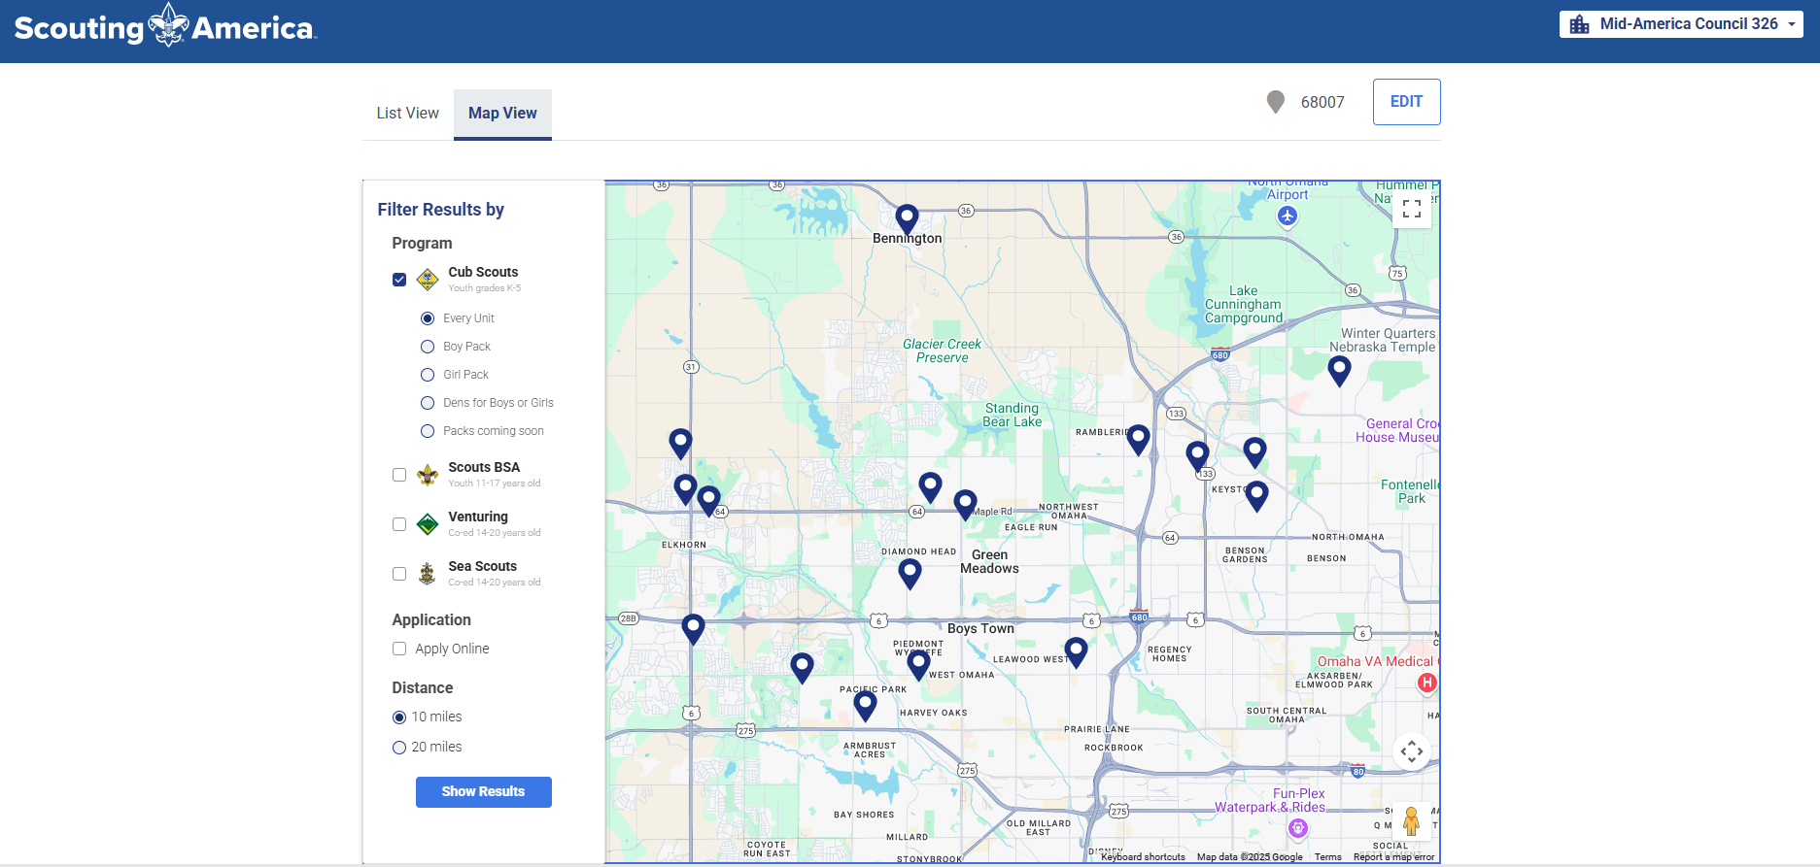

Slide 9
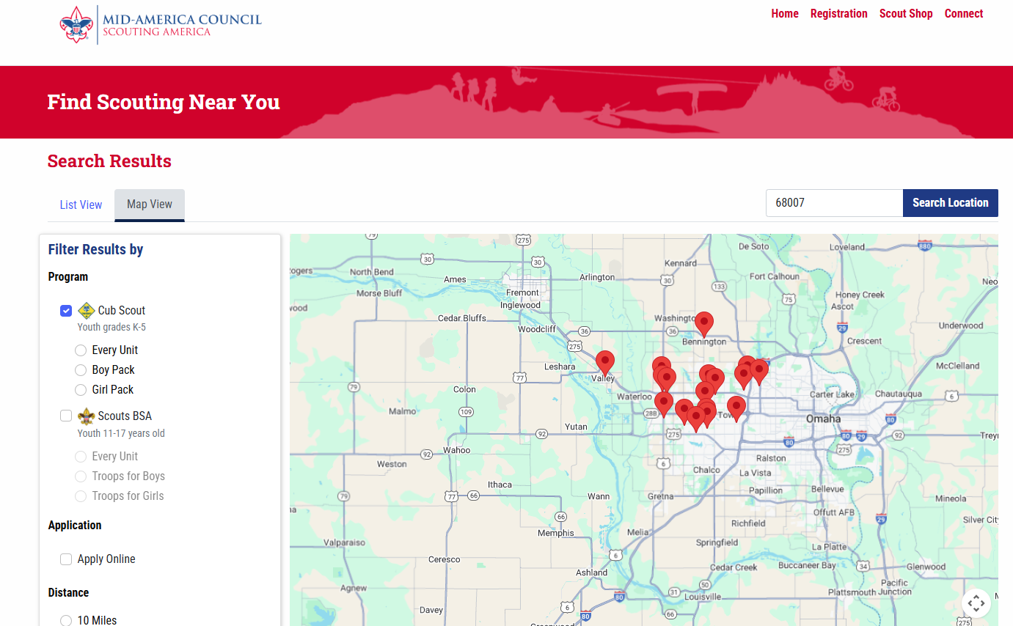

Slide 10
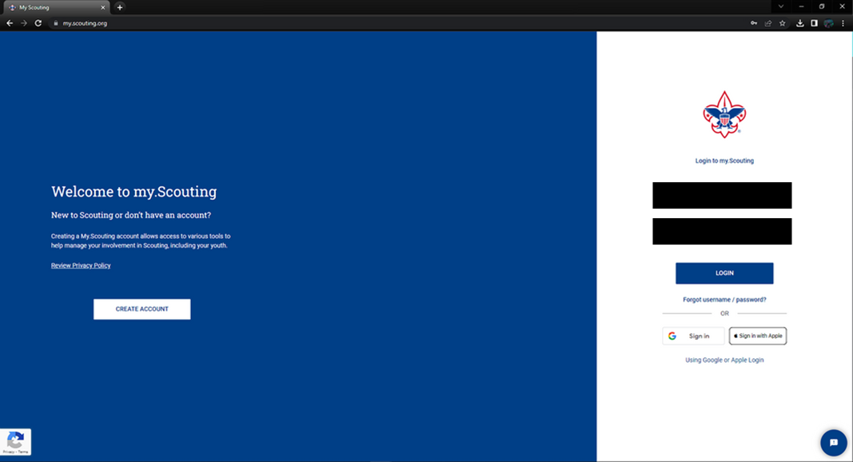
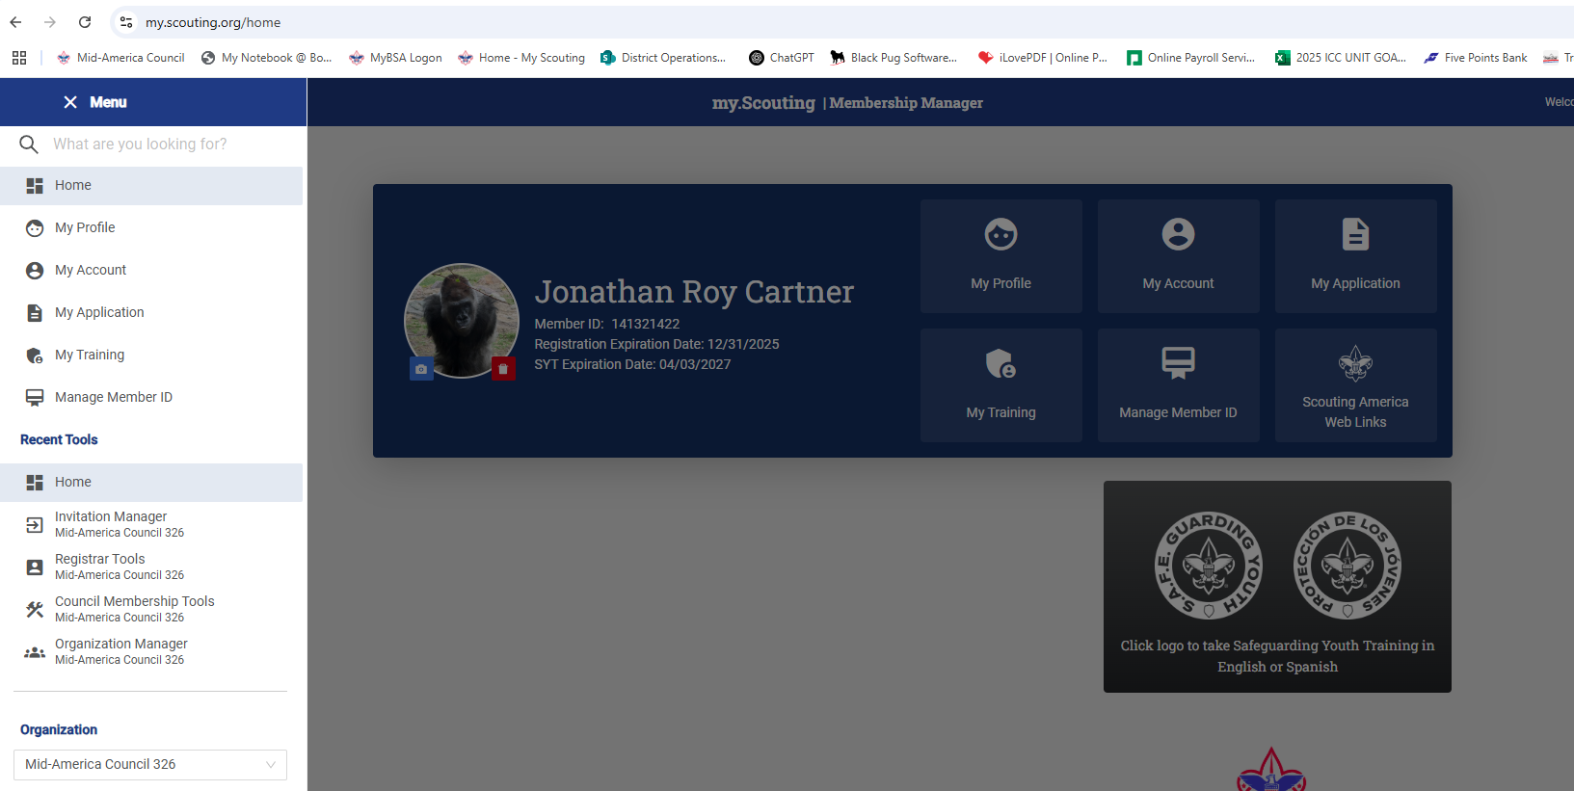
BeAScout Pin - How to Update Your Pin
Log Into My.Scouting.org
Go to the Organization Manager

Slide 11
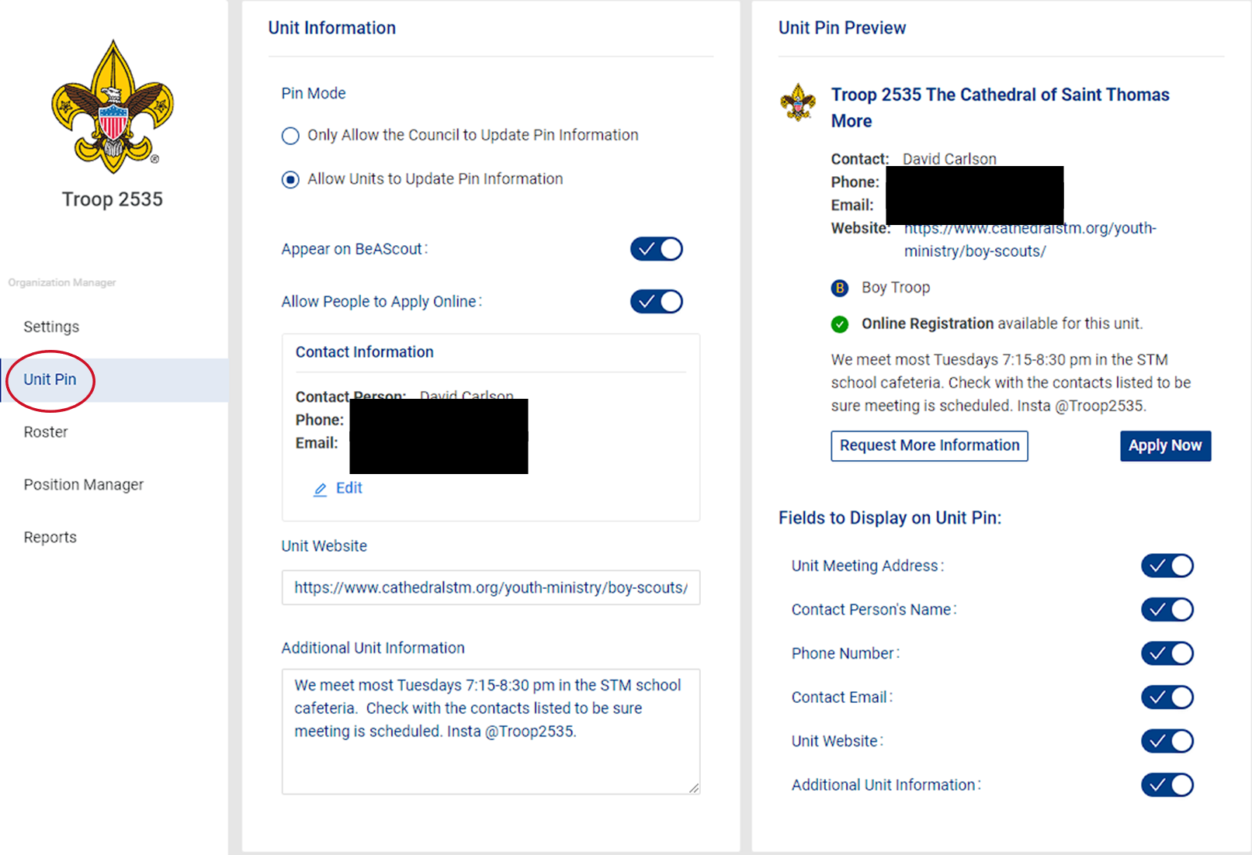
Updating information
  Select Unit Pin on the left-hand side of the screen. You will now see the fields available for setting up your BeAScout Pin.
  Update the following Fields:
    Appear on BeAScout
    Contact Information
    Unit Website
    Additional Unit Information
    Fields to Display on Unit Pin

Slide 12
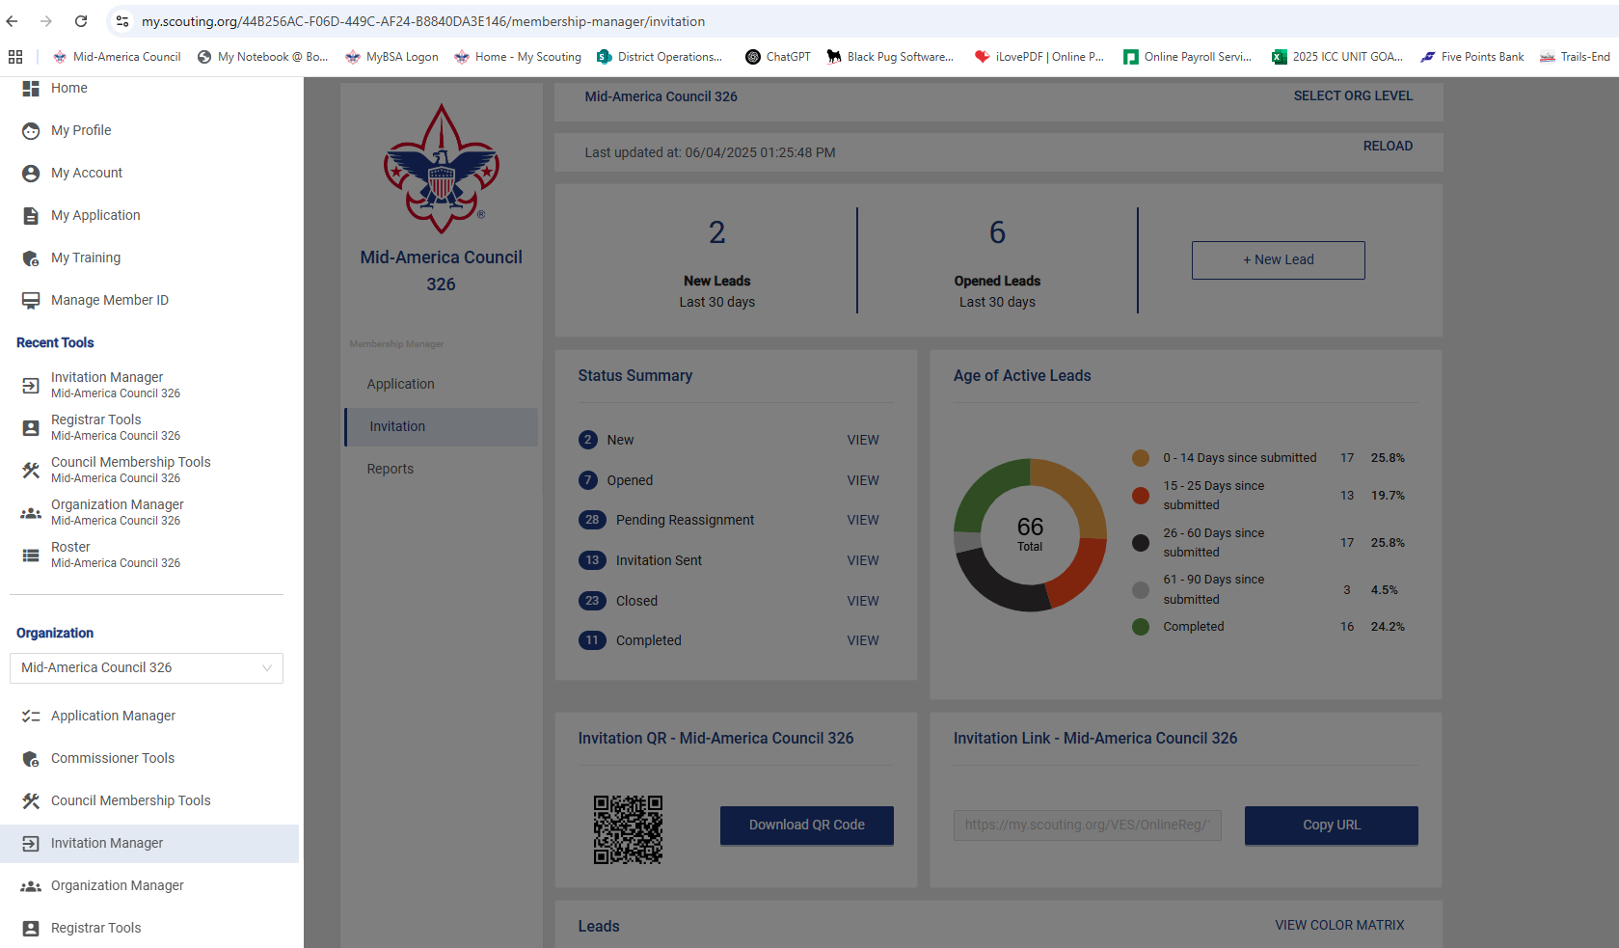

Invitation Manger is your leads resource tool. This is where any inquiries from BeAScout will come in and await your response. You can also add leads manually during joining events or from names provided by unit members and send invitations to join that include a link to your unit’s application. There is also a URL and QR code specific to your unit that can be downloaded from this tool to use in your unit’s recruitment efforts.

Slide 13
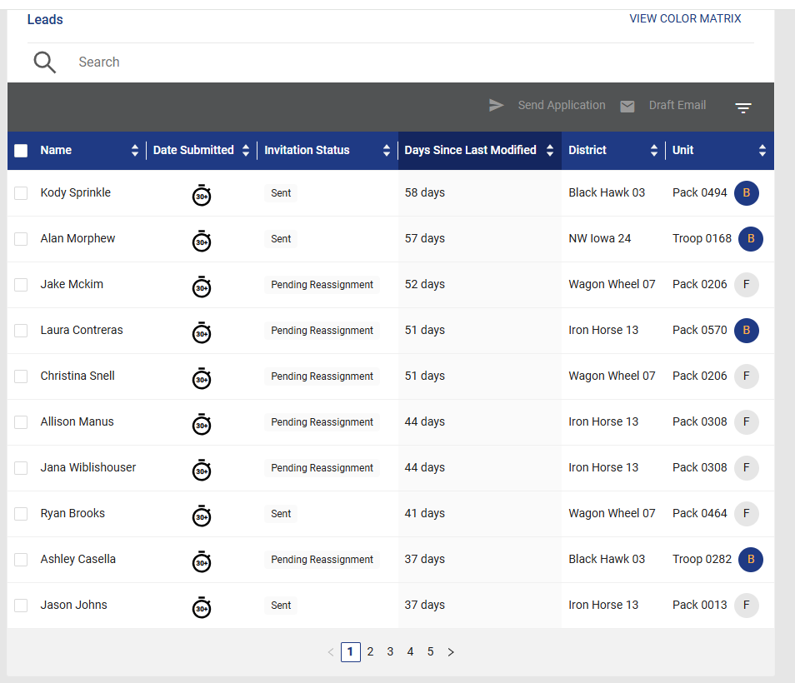
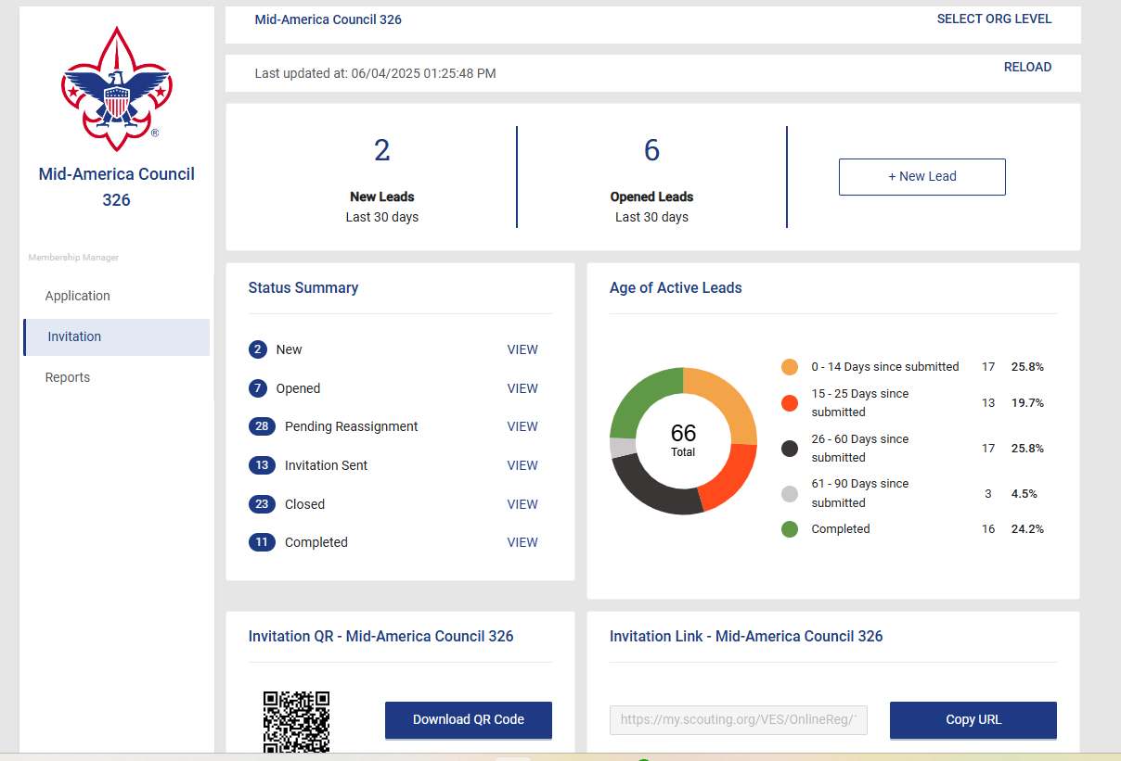

Slide 14
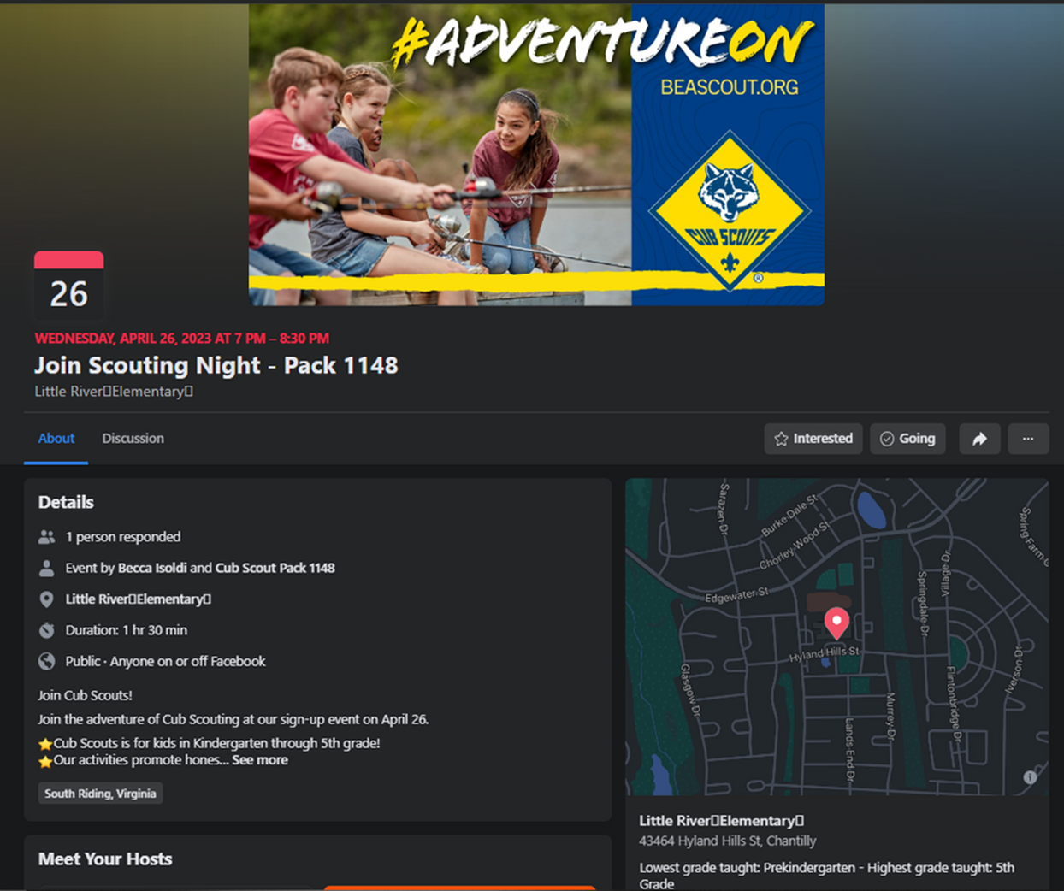
Facebook Geofencing
  What is Geofencing?
    “The use of GPS or RFID technology to create a virtual geographic boundary enabling software to trigger a response when a mobile device enters or leaves a particular area”
  What do we use Facebook Geofencing for?
    Target families with Scout-aged youth and send information about Join Scout Nights
  How it helps
    Reminds families in the geographic boundary about their local Unit’s JSN
    Shows the number of interested / attending families
    Families can invite one another or share the event with one another
  Timing
    We need at least 3 week’s notice to Geofence an event - 1 week to create the event and 2 weeks to advertise it

Slide 15
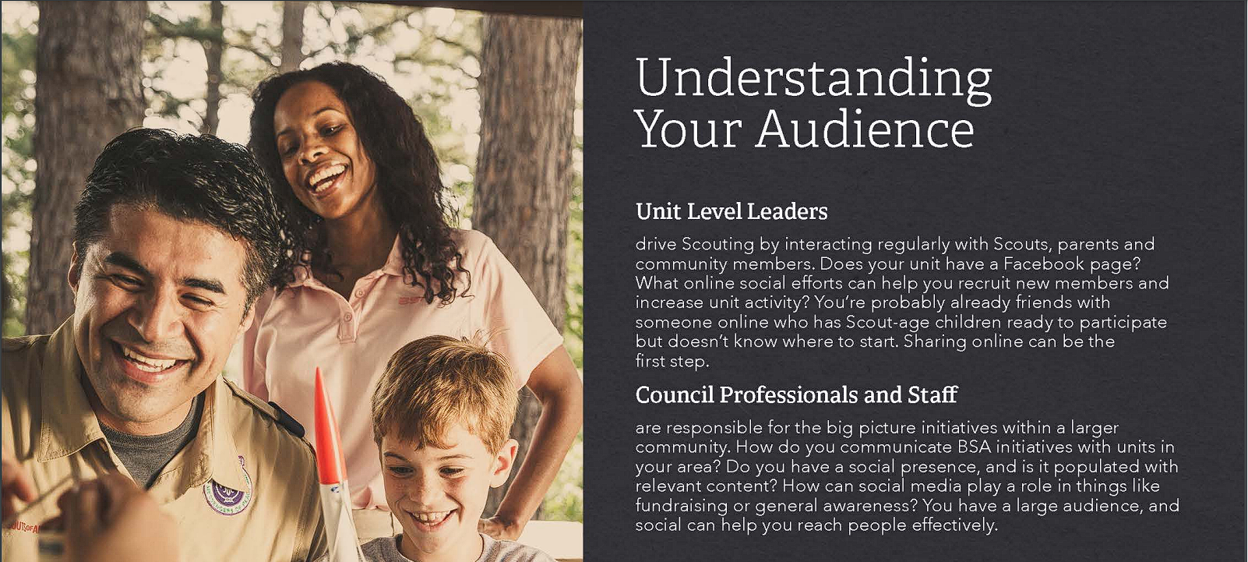
Social Media Presence

Slide 16
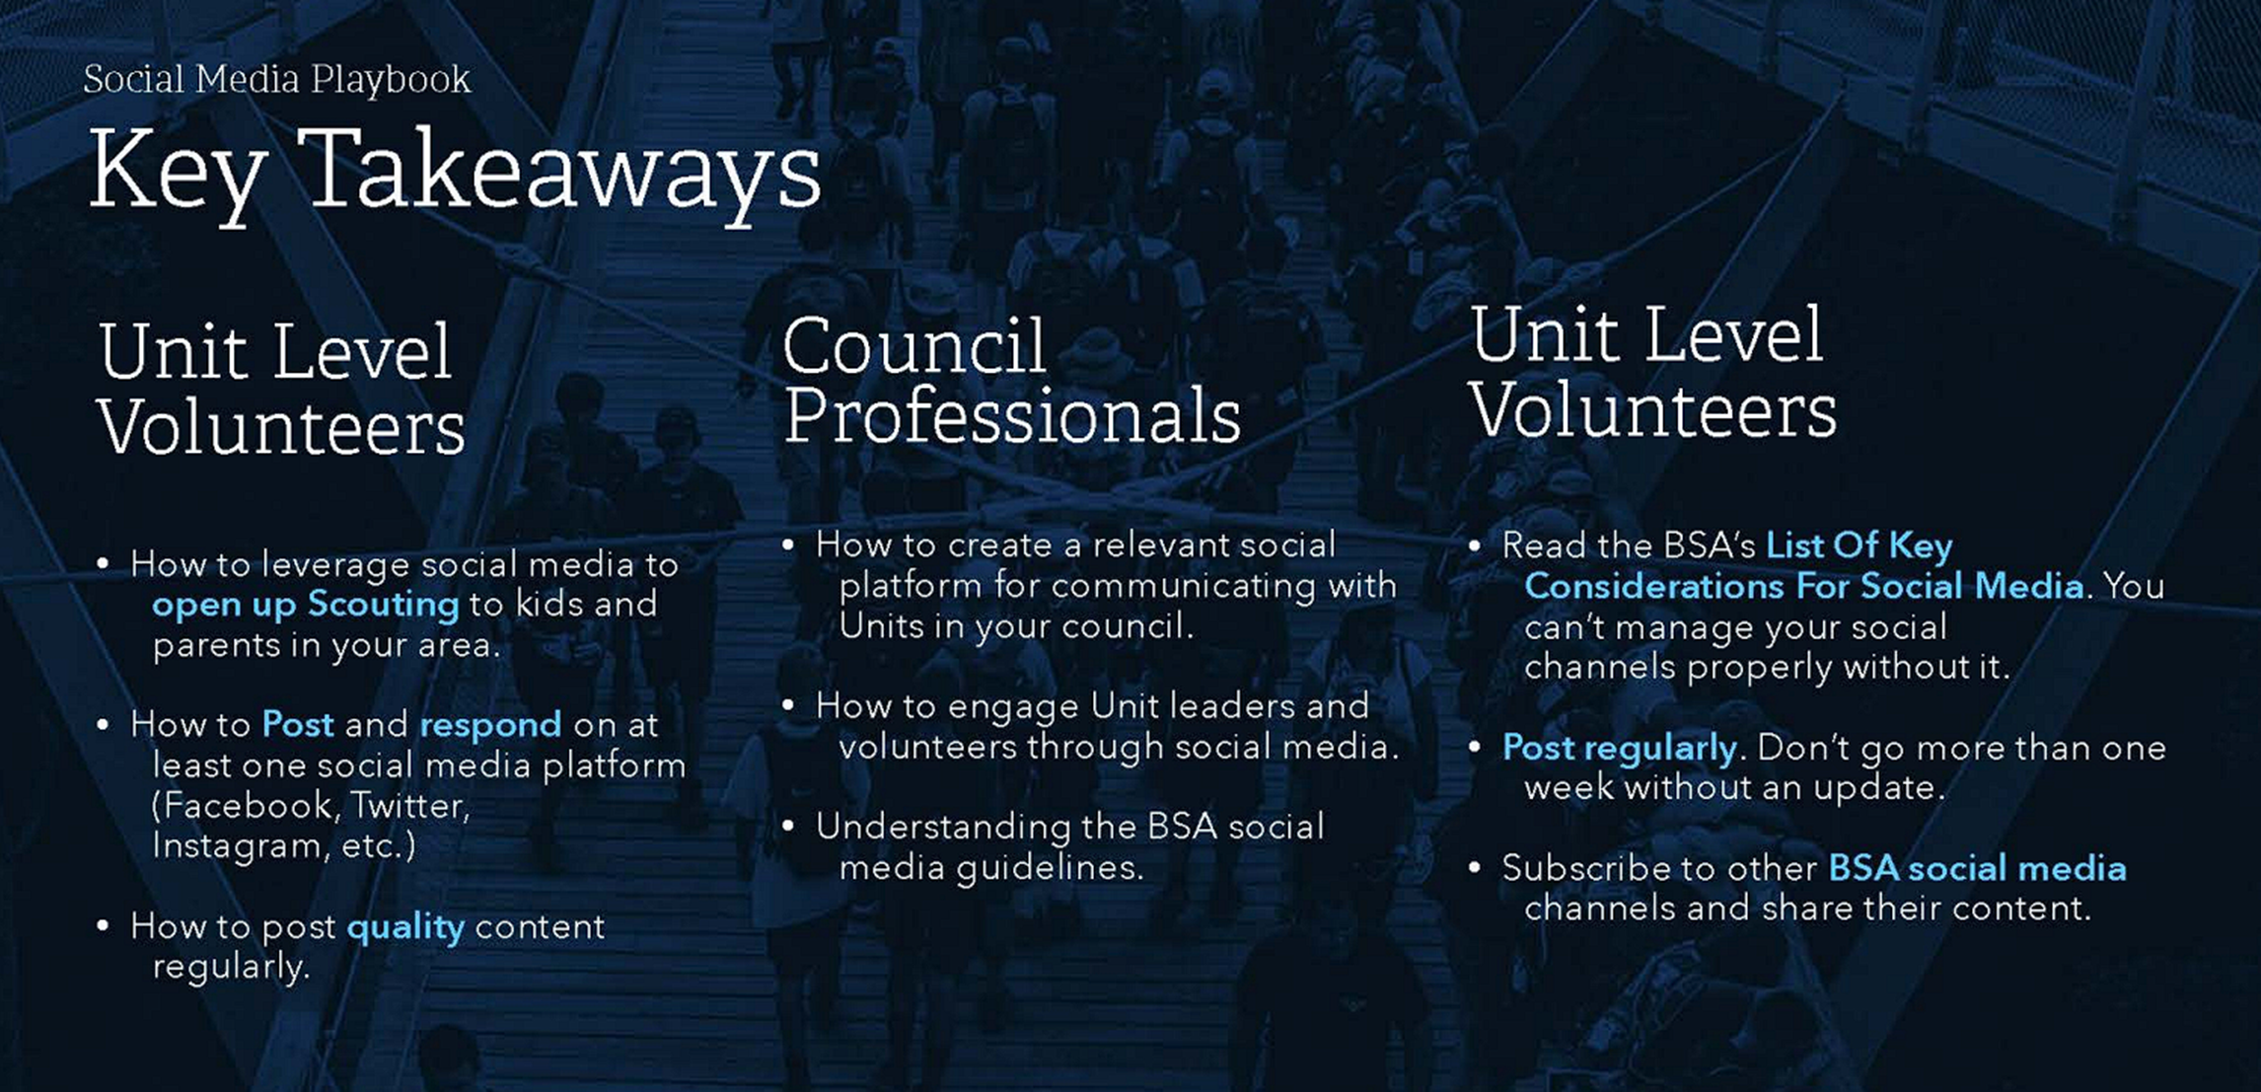

Slide 17
Marketing tactics
  Back to School Nights
  PTO/PTA Newsletters
  Neighborhood Newsletters
  Religion Institution bulletins
  School Blasts / Electronic Flyer Distributions
  Parenting Groups
  NextDoor
  Popup Events

Slide 18
Recruiting Events

Slide 19
Creating Opportunities to join
What are opportunities to join?
  Open houses
  School Nights
  Den Meetings
  Pack Meetings
  Pack activities
  District/Council activities
  Pop up events

Slide 20

Planning the event
The key to a successful sign-up event is thorough planning. You will need to work closely with the school or community center you are using, organize volunteers, and be prepared with any necessary materials such as information fliers, sign-up forms, and even treats. Planning should begin at least eight weeks in advance of the event. Below is a suggested outline for planning your event.
Organize
Team
Organize
Team
Get Help
Get Trained
Reserve
Spot
Have Fun
Set Goals

Slide 21
Promoting Event
In-School Promotion
  Distribute sign-up event fliers the week before the sign-up event
  Posters and yard signs around school
  School rallies or Scout talks at the school
  Back-to-school open house events, school carnivals, and conferences
  Electronic backpacks
  Invite current youth and parents to attend lunch at school in uniform
  Videos on in-school video networks
  School newsletter or website
  School marquee signs
Out-of-School Promotion
  Ask current members to use social media to let their friends and family know about sign-up event nights
  Personalized invitations, emails, and personal phone calls to prospective parents
  Door hangers and door-to-door invitations
  Recruit-a-friend and other peer-to-peer recruiting initiatives
  Fliers and Scout talks at after-school programs or churches in the community
  Church and community websites, calendars, and bulletins
  Press releases
  Billboards, posters, and yard signs in the community (businesses, churches, etc.)
  Community fairs, parades, and other events

Slide 22
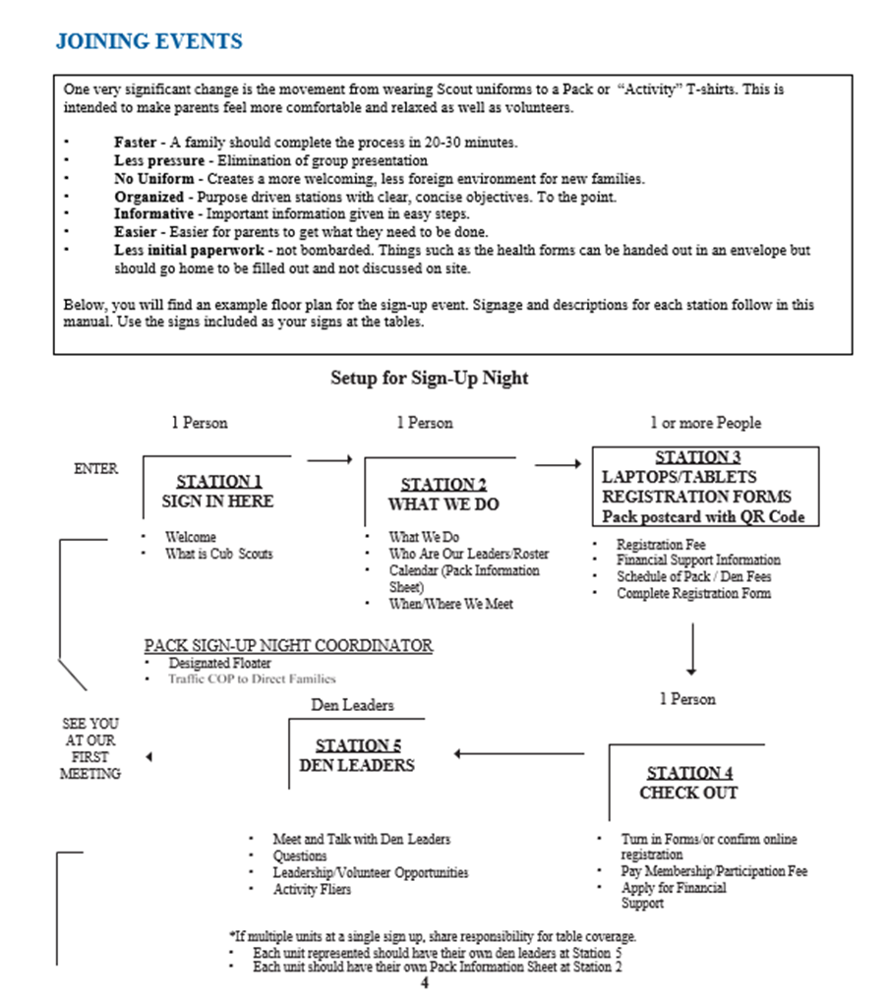
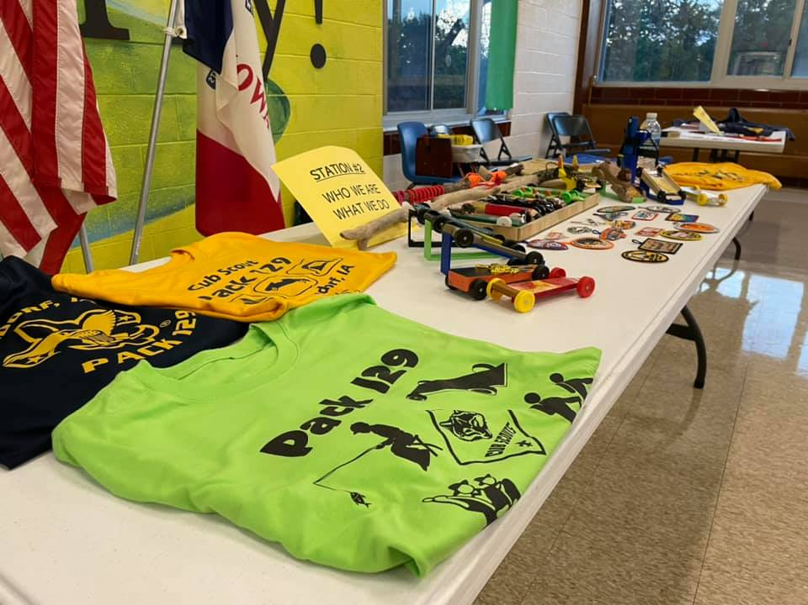
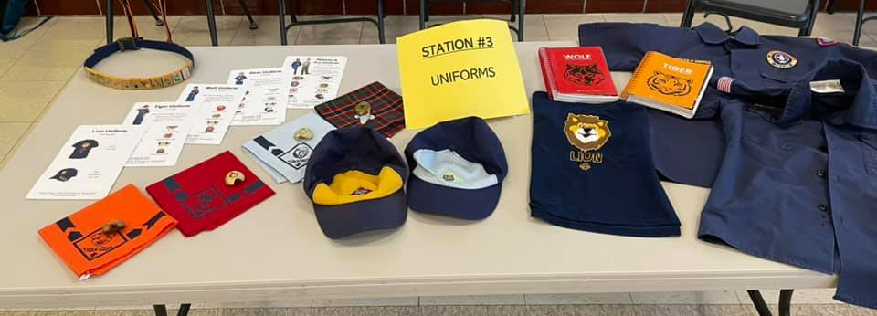
Holding the Event
Sign-Up Night Station Model
Welcome/Sign in
What we do
Registration
Check out/Activity
Leader Q&A

Slide 23
Food for thought
Tranistioning Webelos
School Relationship
Unit Partnerships
  Community based recruitment
  Pack to Troop partnerships

