Slide 1

Unit 123
2025 Popcorn Sale

Slide 2
Kick Off Outline
  Gathering/Opening
  Why Popcorn
  Important Dates
  Goals
    Unit & Scout
  Technology/App
  Products
  How to Sell
    Storefront
    Wagon
    Online
  Incentives
    Unit
    District & Council
  Other Unit Specific Sale Details (Contact person, hours to come by for popcorn, etc)
  Q & A

Slide 3



Why Popcorn?
Fund your unit’s adventures
  Plan your Calendar & Budget with Popcorn sale in mind
  Provides the opportunity for the Unit to provide an outstanding program at low out-of-pocket expense.
Scouts Learn
  The value of hard work
  How to earn their own way
  Public speaking
  Salesmanship & people sills
  Setting and achieving goals
Notes:
Benefits for Scouts
Personal growth program that can be applied to advancement opportunities and service projects.
Earn eGift Cards
More than just Amazon this year!
Scouts choose the prizes they want
Units should also be planning/budgeting what does your Scouts and families get out of participating. Do you have a prize program with those instant rewards?
Are the Scout saving for a big trip. National Jambo is coming in 2026, Troops should take in consideration how their Scouts will fund this – do they know how much they will have to sell this year and next to afford it.

Slide 4
Key Popcorn Dates
September 5 | Sale Begins!
Notes:
ADD other important dates for your unit here!

Slide 5
Goals
Unit Goal
Scout Goals

Slide 6
Use the Technology!
Trail’s End App for Scouts
Text APP to 62771 to download/register your Scout
NEW: Unit ID code
Record sales and accept credit cards
Sign up for storefront shifts
Track your goal
Record when you’ve delivered product
Share your online sales link
Claim rewards!
OUR UNIT CODE:
Reminder: ALL credit card fees paid for by TE/Council when sales are recorded via the app

Slide 7
Use the Technology!
Trail’s End App for Scouts
Scouts will enter the Unit Code at registration.
Easier for Scouts to register.
Returning Scouts should use their previous account.
Be sure to remind them to check their Unit.
Multiple Scout Families:
One Scout per account.
Toggling makes switching between Scouts easy.
Scouts should each get rewarded for their individual hard work.
Multiple parents/guardians logging in:
Use same username & password
Add multi. MFA contacts.
Cell phone recommended
Tip: If they say they have registered, but not showing in your roster, have them look at their unit info.
Notes:
If they do not have their login info they can use the “forgot” features.
If you are a pack and you have Scouts that crossed over to a troop please move them to their new troop, if you have not done so yet.
They can also move their own accounts from the settings tab of the app.
If they have an old account that hasn’t been logged into, for 12 months, it should reactivate once they log in and should show up in your roster again. Or you can submit a ticket to Trail’s End.
I highly recommend talking to your families that typically put multiple Scouts under 1 account. Rewards/incentives are on a per account basis.
For example, there is only ONE patch. Accounts with multiple names on them will be excluded from things like the Top 50 spin party, etc.
Some of the updated tech features we will talk about will become available throughout the next couple of weeks.

Slide 8
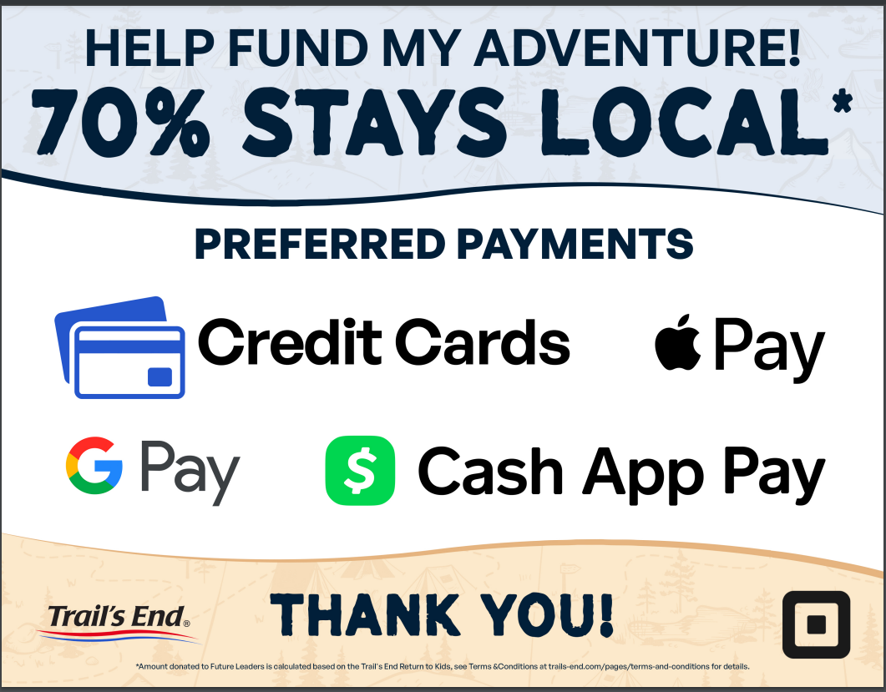
Credit Cards
Many consumers prefer credit or debit card transactions
All Credit Cards transaction fees are covered when recorded via the Trail’s End app
Earn 1.25 reward points for every $1 sold in the app via credit card
No cash handling for Scouts/Unit
  Communicates directly to the Unit.
  Payout available after invoice is $0.
Square readers are compatible with the TE app
  Do NOT use the Square app acct.
Square Bluetooth readers also accept Apple Pay and Google Pay
ALL Scouts can enter credit cards manually
OR send cart to customers device.
  Be sure the payment is verified before letting the customer leave with product.
Parents pay Wagon Sales or Storefront cash due by clicking “Cash to Credit”/“Pay Now” (optional), converting to credit points.
NEW: Tap to Pay – No Reader Needed!
Notes:
Consumers carry less cash and are typically willing to spend more when using credit
Scouts earn more points wit credit.
Safer for the Scouts and Unit when there isn’t a bunch of cash.
Plus less frequent bank visits for the treasurer.
Most Units have a payout to the unit at the end of the season, than needing to hand in a check and/or tracking down money from scouts.
Square Brand readers are the only compatible reader, but they are not required.
They app now accepts Google Pay, Apple Pay, or Cash App Pay, in addition to credit and debit.

Slide 9
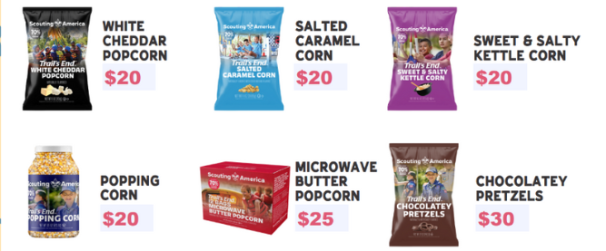
Products
Online Products and Prices may vary from Council orders
Notes:
These are available products and prices for Storefronts and wagon sales. Online products and prices may vary.
*Chocolatey Pretzel will not be available until about week 3 of the sale

Slide 10
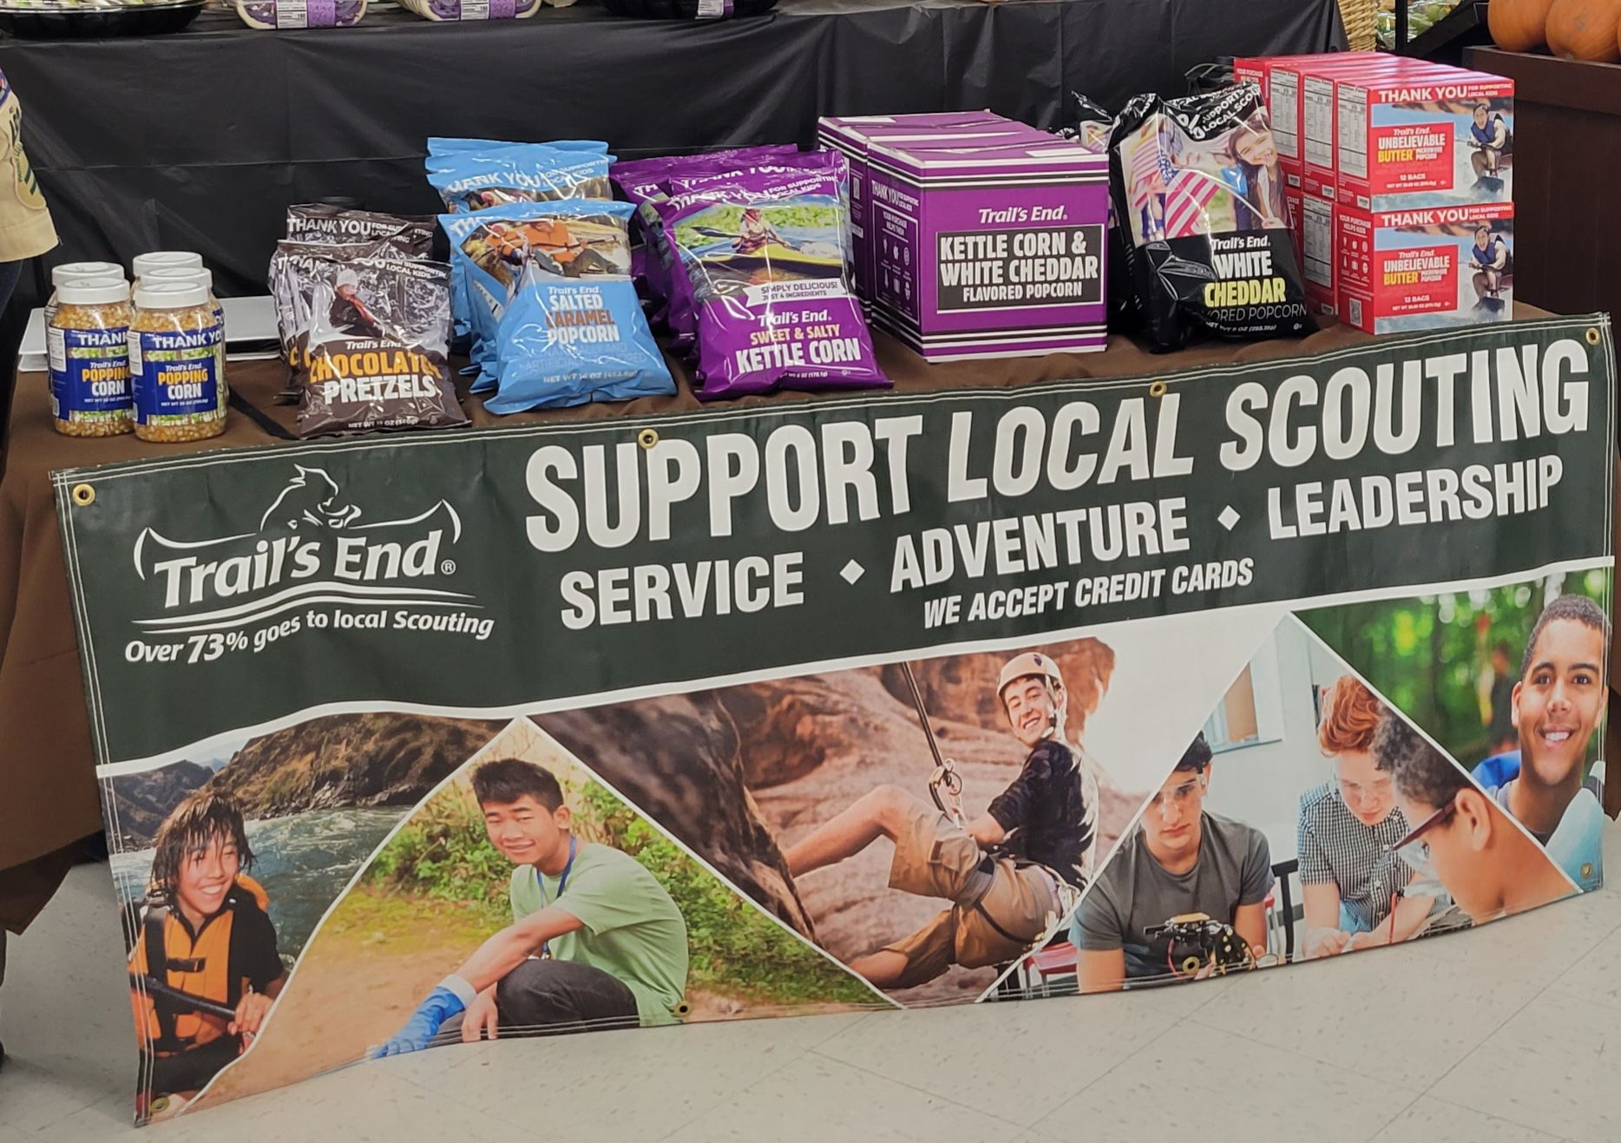
Ways to Sell
Storefront Sales
Reserve storefronts (either via Trail’s End or at the unit level) and then set up booths of product to sell to foot traffic customers of that location
Wagon Sales
Go door to door in your neighborhood, or out to friends and family. They can either buy product on the spot or place an order for delivery later.
Online Direct
Each Scout has a link that they can give out for their online store. Anything ordered via this link will be shipped directly to the customer. Online assortment may differ from on hand inventory. All shipping is $5.99/order

Slide 11
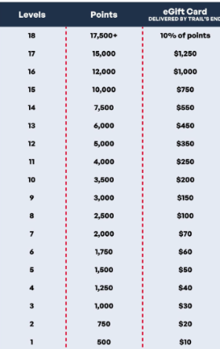
Trail’s End
MUST record all sales via the app to qualify
Scouts earn points
  1.25 points for every $1 sold app credit card and online
  1 point for every $1 sold app cash
  NEW: All Heroes & Helpers sales earn additional .5 points per $1
Unit Leaders submit Rewards at the end of the season and Scouts claim them in their app.
NEW: Choose from multiple stores for your gift cards; Amazon, Target, Dick’s Sporting Goods, Nintendo, and MORE!
  *All sales must be recorded in the app to qualify for any Trail's End rewards
Notes:
TE Bonus Rewards (2025)
To qualify, sales must be recorded in the Trail’s End App and
your Unit must select the calculation method -
One Scout per shift: Scout credited for each sale recorded (Top option on the calculation list).
2025 Bonus Rewards | Jun 30 8PM ET – Nov 30 6:59PM ET
Sell $500 or more per hour per scout
-Earn 1 bonus point per dollar sold
Sell $300-$499 per hour per scout
-Earn 0.5 bonus point per dollar sold
Sell $500 or more online
-Earn 250 bonus points

Slide 12
Council
Each year the council offers additional rewards for our scouts! See below for this year’s details. All prizes are based on sales recorded in the app by 10/28 at 11:59PM.
 | Patch | Popcorn Ball | Spin Party | Trophy
All Sellers | X
$1500 Club | X | X
Top 50 | X | X | X
Top 10 | X | X | X | X
To qualify for any of the rewards provided by council, sales must be recorded in the app.
All prizes not picked up/received by January 31st, 2026 are forfeited.
Notes:
Popcorn Ball and Spin Party details TBD
Patches will not be earlier than February or March

Slide 13
Unit
Notes:
Please add your unit incentives here

Slide 14
Unit Specific Information
Notes:
Please add any unit specific information. Could include:
-Your “Warehouse Hours” for picking up popcorn
-Contact information
-YOUR return dates/allowances, etc

Slide 15
Questions?

